Slide 1
Students Can Make Democracy Work!
West Chicago Community High School Mary Ellen Daneels

Slide 2
CHS Legislative Semester
fulfills Illinois School Code requirements
qualifies as “Democracy School”
taught in heterogeneous classes
inclusive of special education students and bilingual students with support
all seniors participate
integrates technology through the use of threaded discussion boards, web pages, Microsoft Power Point, Microsoft Publisher, Microsoft Word, and research
culminating experience for Social Studies Department
teacher as facilitator
Student directed inquiry

Slide 3
Focus Questions
What is the role of the government in a democratic republic?
What are the rights of individuals in a democratic republic?
How is conflict addressed in a democratic republic?
How is power distributed in a democratic republic?
What is an effective citizen?

Slide 4
Why are these students lined up at 6:00 a.m.?

Slide 5
Rules Committee

Slide 6
D-Day
Students form issue groups of 3-5 students
Each issue group has a distinct bill for the simulation
8 classes x 7 issues a class=56 issues
“First come, first served” to claim issues
Rules Committee oversees process
First to go this semester: Abortion,End Affirmative Action, Doctor-Assisted Suicide

Slide 7
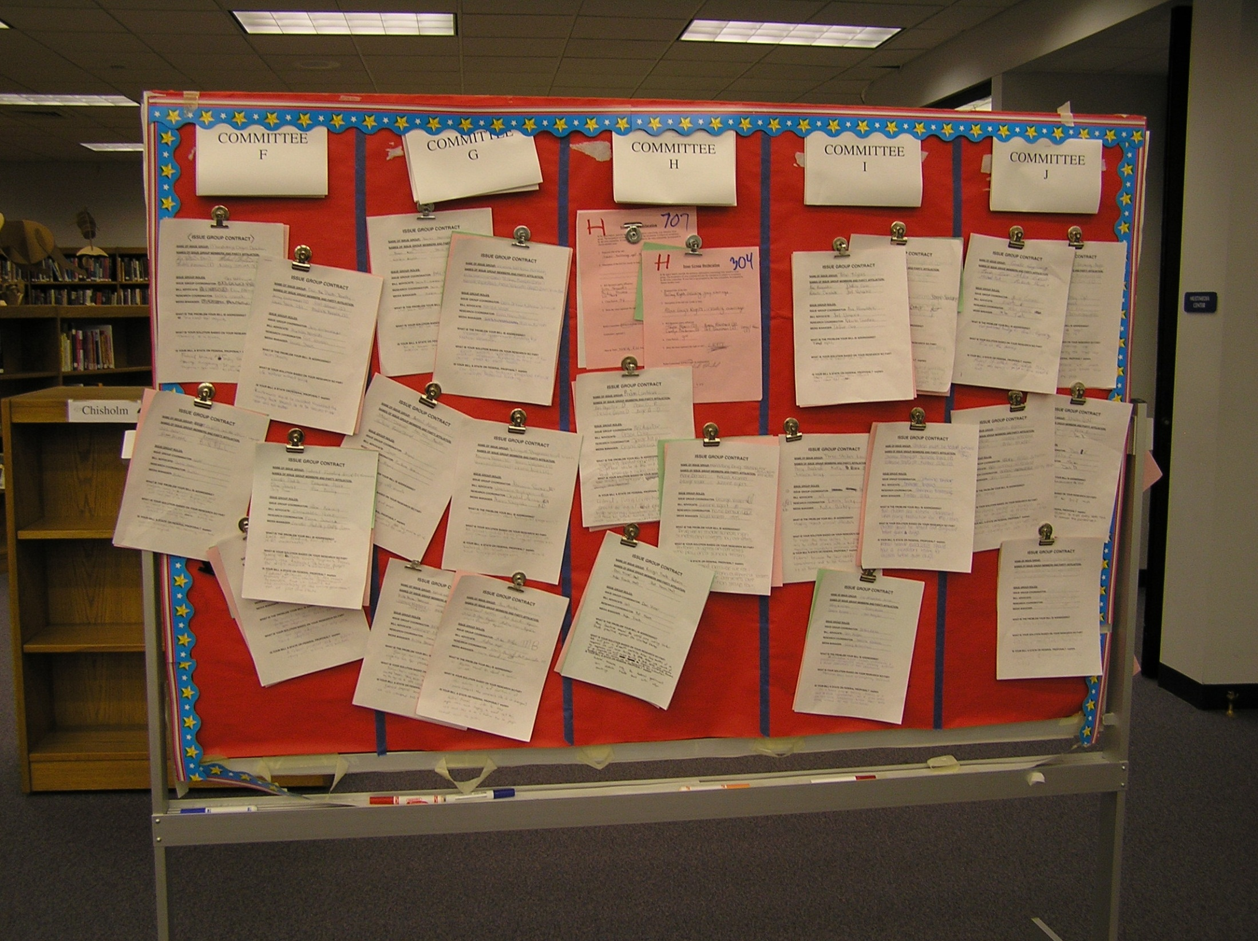

Slide 8
American Government Website

Slide 9
Steps to Bill Writing
Issue Groups brainstorm central questions
Individuals complete research
Individuals complete outline
Groups come together to create common position paper
Groups come together to write bill
Groups work together to advocate for issue for simulation

Slide 10
“Democracy Schools”
Formal Instruction in U.S. government, history, law and democracy using interactive methods and opportunities to apply learning to “real life” situations
Discussion of current events that students view as important to their lives; discussion puts formal civic instruction in context of current political issues
Service Learning: research, advocacy, direct action, indirect action
Student Voice in school governance
Participation in simulations of democratic processes

Slide 11
Student Directed Service Learning
Never doubt that a small group of thoughtful, committed citizens can change the world. Indeed, it's the only thing that ever has." ~Margaret Mead ...

Slide 12
The Spiraling Curriculum
Freshmen Year: Geography
What role do I play in the global community?
Sophomore Year: World History
How does modern history affect the world?
Junior Year: United States History
What does it mean to be an American?
Senior Year: United States Government
What does it mean to be an effective citizen?
Elective: Community Leadership
What does it mean to be an effective citizen in the global community?

Slide 13
Community Leadership
Objectives:
Apply academic, social, and personal skills to improve the community.
Make decisions that have REAL results.
Build leadership skills and increase civic participation.
Make a difference locally and globally.
Students are released from class twice a week to go to service sites
During the semester, students are expected to do 60 hours of service learning

Slide 14
Individual Service Learning Sites
Local P.A.D.S. shelters
Animal Shelter
After-school programs
ESL classes
DuPage Convalescent Center
Wood Glen Nursing Home
St. Patrick’s Nursing Home
State Representative’s offices
Relay for Life Planning Committee
Veteran Relief Services
World Relief
Feed My Starving Children
Recycling
WeGo Care Packs for troops
Spooky Trail
Community Leaf Raking
4Paws 4 You 4 Ever
Much more…

Slide 15
Students in the class:
Meet at least three times a week
Read The 21 Irrefutable Laws of Leadership by John C. Maxwell or Seven Habits of Highly Effective People by Stephen Covey
Complete projects as a class and individual work
Interact with guest speakers that discuss their leadership role in the community and serve as mentors

Slide 16
Community Leadership Class Projects
School-wide recycling
Raise money for local PADS shelter
Freshmen Activity Project
West Chicago Historical Society Immigrant Project
Care Packs for the Troops
WeGo 2 Africa Project to help country rebuild after 20+ years of civil war

Slide 17
WeGo to Africa!

Slide 18
WeGo 2 Africa Mission Statement
WeGo 2 Africa is helping rebuild communities in Angola with educational resources to facilitate learning, living and leadership.

Slide 19
WeGo 2 Africa History
In 2005, CHS raised over $12,000 to build a school in Sakutopi, Angola
In 2006, the International Club, Key Club and Mrs. Haas’ Geography classes collected school supplies to send to Angola.

Slide 20
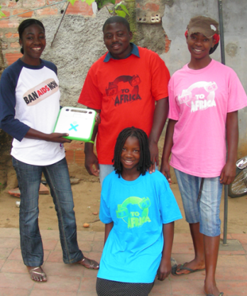
WeGo 2 Africa History
In 2007, CHS raised over $15,000 to send a shipping container full of supplies to Angola. Including computers from the One Laptop Program.

Slide 21
WeGo 2 Africa History
In 2008, CHS raised $6000 to help fund a school in Matala, Angola where 1600 kids attend school outdoors while 7800 children go without an education in that region. The donation was matched by an anonymous businessman.

Slide 22
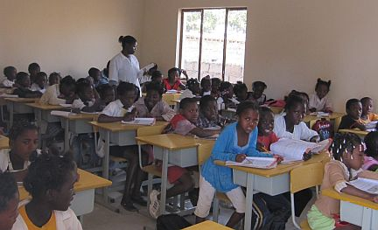
WeGo 2 Africa History
In 2009, a school is built in Caala as a result of the efforts of students and teachers at six US high schools coming together to make a difference--Glenbrook North, Ironwood Ridge, Maine West, Prosser Career Academy, West Chicago and Wheeling!

Slide 23
Fundraising & Donations
Designed and sold WeGo 2 Africa t shirts
Soliciting corporate donations and grants
E-News for donations
West Chicago Park District ad
Battle of the Bands
Teacher Sumo Tournament
Turnabout Dance
“Just Kidding” teacher competition
Lollipop sales
Advisory Fundraisers
Community Presentations

Slide 24
Empower Others to help
Presentations to Middle Schools
Swim team hosts and annual swimathon to raise funds
VFW, Rotary and local churches have donated funds

Slide 25
Colin Hale

Slide 26
Art Club

Slide 27
Teacher’ Association
Teacher’s Association hosted a Mother’s Day Pancake Breakfast and clubs and activities sponsored crafts for kids to make for their mommies.
Profits benefited Africa Project.

Slide 28
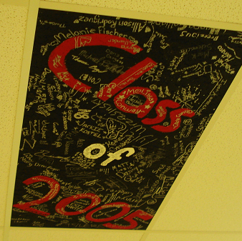
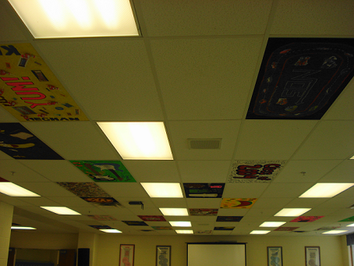
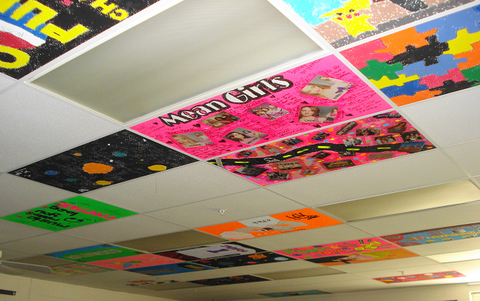
International Club: Paint a Ceiling Tile
Notes:
28

Slide 29
Advisory making dolls for Angola

Slide 30
ABC Posters designed by Art Club

Slide 31
Blankets made by Advisories

Slide 32
Backpacks From Geography Classes

Slide 33
Pre-school selling lemonade for Angola

Slide 34
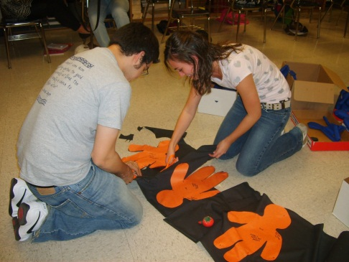
What is the benefit to CHS students?
Organization skills
Building “Social Capital”
Respect for diversity
Attitude of gratitude
Authentic conversations and relationships built as they “work together” on a cause greater than themselves
Looking at community needs
Respect for CHS

Slide 35
What is the benefit to CHS students?
A “Habit of the Heart”

Slide 36
Civic Mission Coalition “Democracy Schools”
Formal Instruction in U.S. government, history, law and democracy using interactive methods and opportunities to apply learning to “real life” situations
Discussion of current events that students view as important to their lives; discussion puts formal civic instruction in context of current political issues
Service Learning: research, advocacy, direct action, indirect action
Student Voice in school governance

Slide 37
Places to start
RDA materials
Project Citizen from the Center for Civic Education; SL curriculum for elementary, middle school and high school
The World We Want documentary about Project Citizen around the world
Center on Congress at Indiana University; The Importance of Citizen Participation
The Center for Civic Education; Representative Democracy in America→Program 6
National Conference of State Legislatures→America’s Legislators Back to School Program

Slide 38
Places to start
Faces of Freedom from the McCormick Foundation
Constitutional Rights Foundation→ Civic Action Project
The Complete Guide to Service Learning by Cathryn Berger Kaye
Learn and Serve America→ www.servicelearning.org
Youth Leadership Initiative→Democracy Corps

