Slide 1
Speech at the Schoolhouse Gate: Categorical Exceptions for Students and Digital Age Challenges
Shawn Healy
Resident Scholar
McCormick Foundation Civics Program

Slide 2
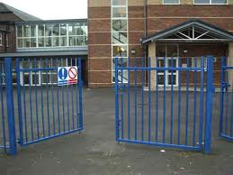
Speech at the Schoolhouse Gate
Student speech and press
- Students in public schools enjoy First Amendment protections depending on the type of expression and their age. The Court has distinguished between elementary and secondary schools and public colleges and universities
-Limitations include:
Material and substantial disruptions: Tinker v. Des Moines (1969)
Vulgar or lewd speech: Bethel v. Fraser (1986)
Reasonably related to legitimate pedagogical concerns: Hazelwood v. Kuhlmeier (1988)
Drug-related speech: Morse v. Frederick (2007)
2
Notes:
2

Slide 3
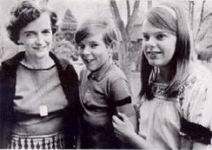
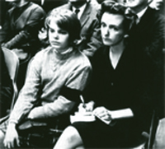
Speech at the Schoolhouse Gate: Categorical Exceptions
Tinker v. Des Moines (1969):
Facts of the case
Issues/ Decisions
Reasoning
Separate Opinions
Discussion
Notes:
MALICE, ACTUAL - Publication of defamatory material "with knowledge that it was false or reckless disregard of whether it was false or not

Slide 4
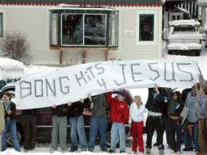
Speech at the Schoolhouse Gate: Categorical Exceptions
Tinker v. Des Moines (1969): “In the absence of a specific showing of constitutionally valid reasons to regulate their speech, Students are entitled to freedom of expression of their views.” Permissible regulation includes “material” and “substantial” disruptions in school discipline
Bethel v. Fraser (1986): Schools may go beyond the maintenance of order in censoring student speech. Expression that is offensive of inappropriate may be censored and punished because elementary, middle, and high school students are not adults, attendance is compulsory, and they constitute a captive audience.
Morse v. Frederick (2007): “Schools may take steps to safeguard those entrusted to their care from speech that can be reasonably regarded as encouraging illegal drug use."

Slide 5
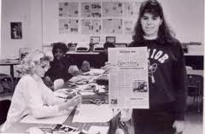
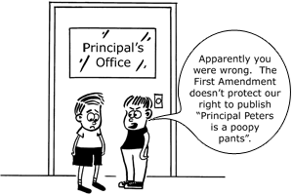
Speech at the Schoolhouse Gate: Scholastic Journalism
Hazelwood v. Kuhlmeier (1988):
Facts of the case
Issues/ Decisions
Reasoning
Separate Opinions
Discussion
Notes:
MALICE, ACTUAL - Publication of defamatory material "with knowledge that it was false or reckless disregard of whether it was false or not

Slide 6
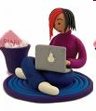
Speech at the Schoolhouse Gate: Digital Age Challenges
Internet Filters
-Children’s Internet Protection Act (2000)
-U.S. v. American Library Association (2003)
Social Networking Sites
Cyberbullying

Slide 7
Speech at the Schoolhouse Gate: Application Exercise
Zelman v. Simmons-Harris (2002), 5-4, constitutional (Rehnquist)
Santa Fe Independent School District v. Doe (2000), 6-3, unconstitutional (Stevens)
Kitzmiller v. Dover Area School District (2005), U.S. District Court for Middle Pennsylvania, unconstitutional
Zamecnik v. Indian Prairie School District (2008), 7th Circuit Court of Appeals, unconstitutional
Wilton (CT) High School, “Voices in Conflict,” never litigated
Snyder v. Blue Mountain School District (2010), 3rd Circuit Court of Appeals, constitutional

Slide 8
Speech at the Schoolhouse Gate: Categorical Exceptions for Students and Digital Age Challenges
Questions?

Slide 9
Speech at the Schoolhouse Gate: The Special Case of Teachers
Shawn Healy
Resident Scholar
McCormick Foundation Civics Program

Slide 10
Speech at the Schoolhouse Gate: The Special Case of Teachers
Pickering v. Board of Education (1968):
Facts of the case: A high school science teacher wrote a letter to the editor of a community newspaper, criticizing the board of education’s allocation of funds between academics and athletics. The school board terminated the teacher, saying that the letter contained false statements that impugned the integrity of the school system. The teacher sued, claiming that the board violated his First Amendment rights by terminating him for exercising his right to freedom of speech.
Issues/ Decisions: Whether school officials violate the First Amendment by terminating a teacher for writing a letter to the editor that discusses important matters of public concern.
By a 8-1 vote, the Court held that school officials do violate the First Amendment when they terminate a public school teacher for speaking out as a citizen on matters of public concern.
Test:
A court must determine whether a public employee’s speech touches upon matters of public concern
If so, the court must balance the free speech interests of the employee against the government’s interest as an employer
Notes:
MALICE, ACTUAL - Publication of defamatory material "with knowledge that it was false or reckless disregard of whether it was false or not

Slide 11
Speech at the Schoolhouse Gate: The Special Case of Teachers
Garcetti v. Ceballos (2006):
First step of Pickering Test further narrowed: When a government employee is speaking within the scope of her government duties, she is not speaking as a citizen, and thus has no First Amendment protection.
A court must determine whether a public employee’s speech touches upon matters of public concern, and be outside the scope of employment
Hazelwood reconsidered:
Although the case considered student speech, the precedent has been extended to teacher speech which is school sponsored
Preservation of school curriculum a legitimate pedagogical concern of the school board
Circuit conflict
Pickering protects teacher classroom speech that addresses matters of public concern
Hazelwood protects teacher classroom speech when the school board has no legitimate pedagogical reason for preventing it
Notes:
MALICE, ACTUAL - Publication of defamatory material "with knowledge that it was false or reckless disregard of whether it was false or not

Slide 12
Speech at the Schoolhouse Gate: The Special Case of Teachers
Mayer v. Monroe County School Corporation (2007, 7th Circuit):
In January 2003, Deborah Mayer was teaching a class of 4th-6th graders at Clear Creek Elementary School
While discussing an article on the demonstrations that preceded the invasion of Iraq in the children’s version of Time magazine (part of school-approved curriculum), a student asked a question about taking part in presentations.
Mayer referenced rallies in nearby Bloomington, and mentioned that she “honks for peace” when prompted by protesters’ signs; she also said that people should consider peaceful solutions before going to war
A student complained to her principal, and he proceeded to cancel the school’s peace rally and also forbade Mayer from discussing the war or her political views in class; her contract was not renewed at the end of the school year for “poor performance” despite a favorable review prior to the incident
The 7th Circuit Court of Appeals ruled:
-"Teachers hire out their own speech and must provide the service for which employers are willing to pay,“
-"The Constitution does not entitle teachers to present personal views to captive audiences against the instructions of elected officials
Notes:
MALICE, ACTUAL - Publication of defamatory material "with knowledge that it was false or reckless disregard of whether it was false or not

Slide 13
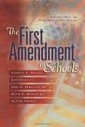
Speech at the Schoolhouse Gate: Application Exercise
73. How do courts balance teachers’ First Amendment rights against the interests of the public school system? (P94)
74. How do courts determine whether a teacher’s speech touches on a matter of public concern? (P95)
75. Does a school violate the First Amendment if it disciplines a teacher for speech that touches on a matter of public concern? (P96)
76. If a teacher is in part terminated for constitutionally protected speech, may a school board avoid any constitutional violation? (P97)
77. Must a public school teacher salute the flag during the recitation of the Pledge of Allegiance? (P98)
78. May a teacher wear clothing not approved by a teacher dress code? (P98)

Slide 14
Speech at the Schoolhouse Gate: Application Exercise (Continued)
80. Is a teacher’s classroom a public forum? (P100)
81. May a teacher be punished for teaching subjects schools officials or parents deem unsuitable? (P101)
82. May a teacher refuse to teach certain materials in class if she feels the curriculum infringes upon her personal beliefs? (P102)
84. May teachers and administrators pray or otherwise express their faith while at school? (P103)
85. How should teachers respond if students ask them about their religious beliefs? (P104)

Slide 15
Speech at the Schoolhouse Gate: The Special Case of Teachers
Shawn Healy
Resident Scholar
McCormick Foundation Civics Program

