Slide 1
Freedom of the Press: Prior Restraint and Libel
Shawn Healy
Resident Scholar
McCormick Foundation Civics Program

Slide 2
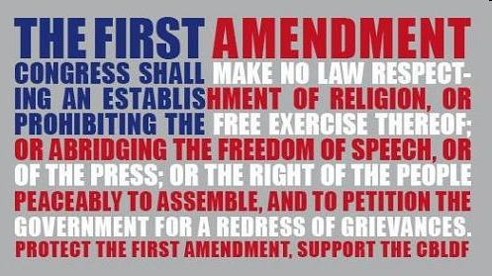
Overview: Freedom of Speech and Press
“Congress shall make no law respecting an establishment of religion, or prohibiting the free exercise thereof; or abridging the freedom of speech, or of the press; or the right of the people peaceably to assemble, and to petition the government for a redress of grievances.”
2
Notes:
2

Slide 3
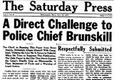
Freedom of Speech and Press
Prior restraint:
-Prohibited with few exceptions
Controlling case: Near v. Minnesota (1931)
-“A form of censorship that allows the government to review the content of printed materials and prevent their publication.”
—Encyclopedia of the First Amendment
-British common law generally opposed government licensing and other forms of prior restraint, and this informed the delegates of the Constitutional Convention and adopters of the First Amendment.
-The Supreme Court has ruled with strong presumption against government use of prior restraint
-The prohibition of prior restraint does not prevent punishment for prosecution after the fact, and protection from prior restraint is not absolute.
3
Notes:
3

Slide 4
Freedom of Speech and Press: Prior Restraint
Reading Jigsaw
Divide into groups of 4
Answer the questions listed below, and later report to the class
Discussion Questions:
Summarize the act, article, or Supreme Court case
Account for contemporaries who dissented to the law or case
How does the law or case relate to prior restraint?
Evaluate the historical implications of the law or case
Readings:
-The Sedition Act of 1798: Freedom of Press Comes Under Attack
-The Colonel’s Finest Campaign: Robert R. McCormick and Near v. Minnesota
-New York Times v. United States
-After 40 Years, the Complete Pentagon Papers

Slide 5
Freedom of Speech and Press: Categorical Exceptions
Not protected by the First Amendment:
-Defamation: Actual malice, knowingly false charges, and reckless disregard for the truth
Controlling case: New York Times v. Sullivan (1964)
-Incitement: Imminence between the call for action and the action itself
Controlling case: Brandenburg v. Ohio (1969)
-Fighting words: Spoken words that instigate violent reactions
Controlling case: Chaplinsky v. New Hampshire (1942)
-True Threat: Distinguish true threats from political hyperbole
Controlling case: Watts v. United States (1969)
-Obscenity: Apply three-part Miller Test
Controlling case: Miller v. California (1971)
5
Notes:
5

Slide 6
Categorical Exceptions: Libel
Libel:
Libel: “Any publication that is injurious to the reputation of another.”
Slander: “Speaking of base and defamatory words tending to prejudice another in his reputation, office, trade, business, or means of livelihood.”
During Norman times, guilt initially determined by church; later the British judicial system
Guilt premised on damage to reputation, liability escaped if statements proven true
Prior to the Sullivan case, a plaintiff in a libel case needed to prove the following:
The defendant made the statement
The statement was about the plaintiff
The statement was defamatory
The statement injured the plaintiff’s reputation

Slide 7
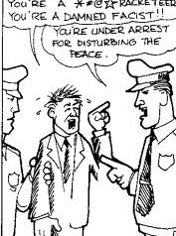
Categorical Exceptions: Libel
Chaplinsky v. New Hampshire (1942):
Walter Chaplinsky, a Jehovah’s Witness, instigated a riot upon speaking and distributing pamphlets critical of organized religion in Rochester, NH
Upon arrest, he uttered, “You are a God damned racketeer” and “a damned fascist and the whole government of Rochester are fascists or agents of fascists.”
Chaplinsky was charged with violated a NH law the prohibited offensive, derisive, or annoying words” toward others or preventing them from going about their daily lives.
He challenged the law on First and Fourteenth Amendment grounds
Justice Francis Murphy wrote for a unanimous Court, which ruled that certain spoken words that instigate violent reactions are exempt from First Amendment protections.
This included speech that is “lewd and obscene,…profane,…libelous,…and insulting or ‘fighting words.’”

Slide 8
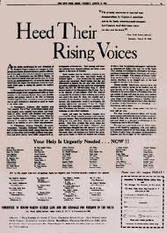
Categorical Exceptions: Libel
New York Times Company v. Sullivan (1964):
Facts of the case
Issues/ Decisions
Reasoning
Separate Opinions
Discussion
Notes:
MALICE, ACTUAL - Publication of defamatory material "with knowledge that it was false or reckless disregard of whether it was false or not

Slide 9
Categorical Exceptions: Libel
Fact Pattern Application: Does this constitute libel?
An article in a conservative magazine criticizes the lawyer of a police officer who shot and killed a youth, calling him a “Leninist” and a “Communist-fronter,” he also implicated him in a Communist plot to attack the Chicago Police during the 1968 Democratic National Convention. Many of these statements were factually incorrect and the author did little to verify them.
--Gertz v. Robert Welch, Inc. (1974)
A college athletic director is accused of fixing a football game by a weekly magazine. He sues the publisher on the grounds that the story was based on a tip provided by a man on probation, the reporter did not check the game film for evidence of a fix, nor did he have any expertise in football strategy.
--Curtis Publishing Co. v. Butts (1967)
Notes:
Gertz: public/ private official distinction; Curtis: Warren added public figure to the mix in a plurality decision

Slide 10
Categorical Exceptions: Libel
Fact Pattern Application: Does this constitute libel?
An article in a local daily newspaper links a chain of beverage stores to organized crime. A principal stockholder that owns the chain filed suit, claiming the newspaper must prove the accuracy of this implication in order to stave off a libel judgment.
--Philadelphia Newspapers, Inc. v. Hepps (1986)
A high school wrestling coach is accused of lying under oath at a public meeting by a local newspaper columnist. He alleges that the column asserts that he committed perjury, and the newspaper counters that the column was opinion, and therefore protected.
--Milkovich v. Lorain Journal Co. (1990)
Notes:
Hepps: plaintiffs must prove falsity, and when falsity cannot be determined, media defendant prevails; Milkovich: opinions can be defamatory and there is no broad constitutional protection for them

Slide 11
Freedom of the Press: Prior Restraint and Libel
Questions?

Slide 12
Freedom of the Press: Digital Age Challenges
Shawn Healy
Resident Scholar
McCormick Foundation Civics Program

Slide 13
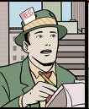
Freedom of the Press: Digital Age Challenges
Overview:
Historical perspective
Broken economic model
Fragmented, competitive media environment
Altered relationship between media producers and consumers
Proliferation of edge and opinion
Democratization of media
Newspapers’ slow death
Young people “tuned out”

Slide 14
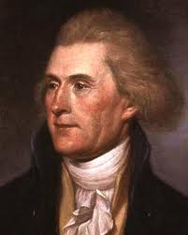
Digital Age Challenges: Historical Perspective
“Were it left to me to decide whether we should have a government without newspapers or newspapers without a government, I should not hesitate a moment to prefer the latter." --Thomas Jefferson to Edward Carrington, 1787.
"The basis of our governments being the opinion of the people, the very first object should be to keep that right; and were it left to me to decide whether we should have a government without newspapers or newspapers without a government, I should not hesitate a moment to prefer the latter. But I should mean that every man should receive those papers and be capable of reading them."
Notes:
Search for infamous Jefferson quote; even more meaningful and pertinent in context

Slide 15
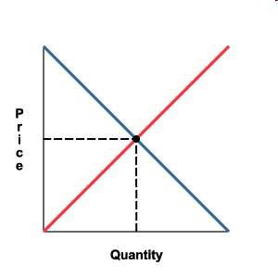
Digital Age Challenges: Historical Perspective
Economics 101
Supply: “…Whether we should have a government without newspapers or newspapers without a government…”
Demand: “…Every man should receive those papers and be capable of reading them.”
Equilibrium=Democracy: “The basis of our governments being the opinion of the people…”
Democracy
Quantity
Notes:
Jefferson through the eyes of a former high school economics teacher…

Slide 16
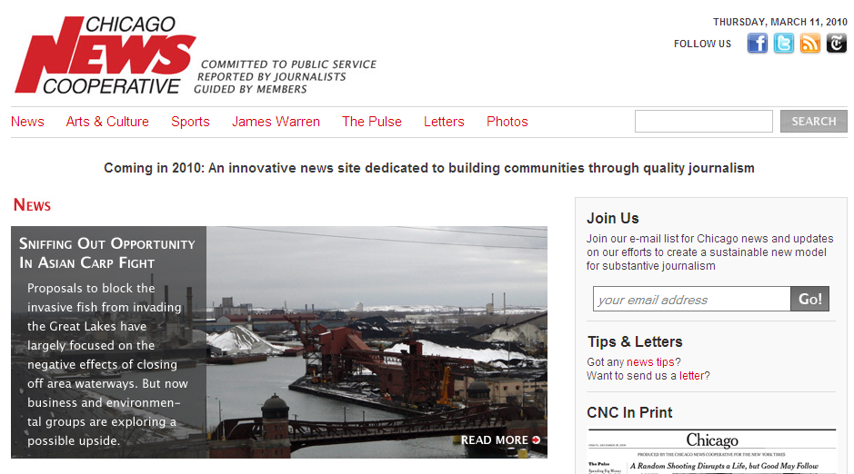
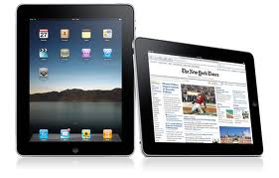
Information Age Challenges Broken Economic Model
The economic model of journalism is broken:
-Advertisers historically subsidized the costs of reporting and printing
-Subscribers merely paid for delivery costs
-The decline of both has fueled a downward spiral
-Who will bear the costs of investigative reporting?
-Many online entities like Salon and Politico are operating at a loss.
-Thus, the rise of alternative models…
▪Non-profits (Chicago News Cooperative)
▪Online payments (New York Times)
▪Handheld devices (iPad)
Notes:
Do you subscribe to a daily newspaper? Weekly magazine? How many of you use the Internet as a source for news? Would you pay for it?

Slide 17
Information Age Challenges: Fragmented, Competitive Media Environment
Readers and news consumers are now more abundant than ever,
but they exist in a fragmented, competitive media environment.
-Decline of network news accompanied by cables news’ rise
-Local TV news remains profitable
-”If it bleeds, it leads”
-Corporate ownership and public good in conflict
Notes:
Who watches TV news? What channels/ programs do you watch?

Slide 18
Information Age Challenges: Altered Relationship Between Producers and Consumers
The relationship between news providers and consumers is no longer one-way, but instead reciprocal.
-Reader comments and page clicks enable immediate feedback.
-Packaging less important nowadays than individual stories
-Newsroom hierarchy turned on its head
Notes:
Does anyone frequently leave comments on online news stories?

Slide 19
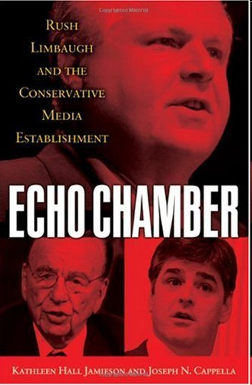
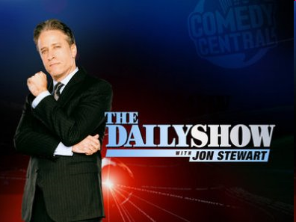
Information Age Challenges Proliferation of Edge and Opinion
News consumers are increasingly interested in edge and opinion:
-Personalities, not the news itself, takes center stage
-This is accompanied by a retreat to partisanship in our press, and…
-A turn to satirical and soft-news programs as a source for political information
Notes:
What motivates you to watch the TV news network channel/ program you do?

Slide 20
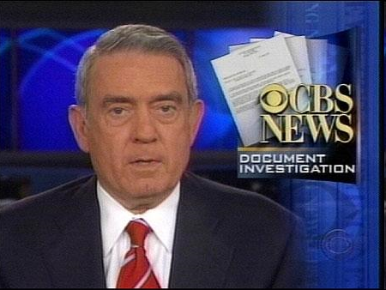
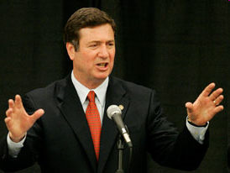
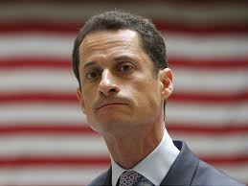
Information Age Challenges Democratization of Media
News is delivered in more viral forms, for we are now all able to publish:
-Stories are forwarded via cyberspace, posted on social networking sites
-Bloggers revealed CBS’ use of falsified documents in connection to the Bush National Guard Story in 2004
-Social media holds political candidates to new levels of accountability
-Rise of citizen journalists
-Return to the First Amendment’s original roots?

Slide 21
Information Age Challenges Newspapers Slow Death
“Do Newspapers Matter?”
-Study by Princeton economist Sam Schulhofer-Wohl
(March 13, 2009)
-Focal point: December 31, 2007 closing of the Cincinnati Post, leaving only the larger Enquirer
-Search for a “substantial and measurable impact on public life” in surrounding Kentucky counties that represented the Post’s readership base
-Past research has shown:
1. Higher newspaper readership=less corruption
2. Cities with daily or weekly papers less likely to re-elect incumbents
3. Editorial endorsements affect ballot box behavior
-Among their findings:
1. Fewer candidates for municipal office
2. Incumbents more likely to be re-elected
3. Lower voter turnout
Notes:
Obituaries: Rocky Mountain News, Seattle Post-Intelligencer, Christian Science Monitor, Capitol Times

Slide 22
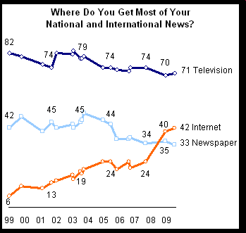
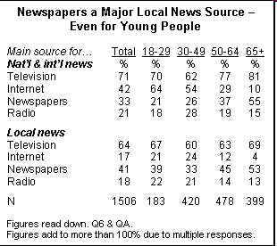
Information Age Challenges Young People Tuned Out
“Press Accuracy Rating Hits Two Decade Low”
-Report published by the Pew Center for the People and the Press (Sept 13, 2009)
Notes:
Where do your young patrons/ students get their news?

Slide 23
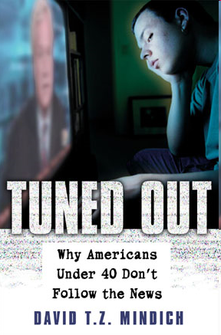
Information Age Challenges Young People Tuned Out (Continued)
“Young People and the News”
-Report prepared by Thomas Paterson of the Shorenstein Center on the Press (July 2007)
- Newspapers? Only 9% of teenagers read a newspaper daily, 46% hardly ever/not at all
-National television news? 31% of teenagers watch national TV news daily, 22% several times a week, and 23% once a week. Similar numbers for local news.
-Radio? 25% listen to radio news daily, 13% several times a week, and 18% once a week.
-The Internet? 20% use the internet as a news source daily, 23% several times a week, and 15% once weekly. A full 32% do not use the internet as a news source.
-Young people watch non-news related programming and read magazines and books in similar numbers with older adults (Source: Pew Research Center Biennial News Consumption Survey, 2004)
Notes:
Where do your young patrons/ students get their news?

Slide 24
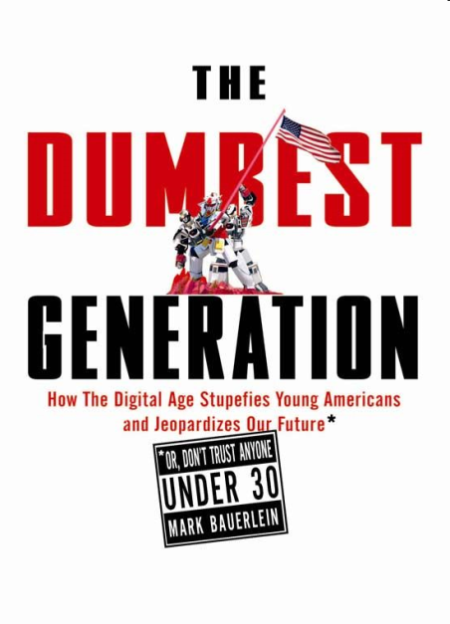
Information Age Challenges Young People Tuned Out (Cont.)
Written by Mark Bauerlein (2008), selected excerpts:
-Opportunity: “All the ingredients for making and
informed and intelligent citizen are in place. But it hasn’t
happened.”
-Outcome: “Most young Americans possess little of the
knowledge that makes for an informed citizen, and too
few of them master the skills needed to negotiate an information-heavy, communication-based society and economy.”
Paradox of the Dumbest Generation
-The Problem: “Uninterested in reading and unworried about the consequences, kids reject books as they do vegetables, and the exhortations of their teachers fall flat. A quick glance at their newspaper once a day would augment their courses in government…But those complements don’t happen.”
-The Consequences: “Democracy requires an informed electorate, and knowledge deficits equal civic decay. Individual freedom means the freedom not to vote, not to read the newspaper, not to contemplate the facts of U.S. history, not to frequent the public square—in a word, to opt out of civic life.”
Notes:
Where do your young patrons/ students get their news?

Slide 25
Information Age Challenges Young People Tuned Out (Continued)
A Potential Solution: News Literacy
- News literacy defined: “The ability to determine the credibility of news reports and other information, whether delivered through print, television, radio or the Internet.”
- Essential Questions:
1. How does one define news, opinion, advertising, publicity, entertainment, propaganda, and raw information?
2. What is the difference between assertion and verification?
3. What is a source? (Eyewitness/ expert/ independent/ anonymous)
4. What is bias? (Media and audience)
5. What is documentation?
6. What is fairness?
7. Why does context matter?
8. Why do mistakes appear in news accounts? How do journalists learn from them?
9. What standards or limitations exist for putting information on the Internet?
10. How does one determine who created a piece of information? Why is it important?

Slide 26
Freedom of the Press: Digital Age Challenges
Questions?

