Slide 1
News Literacy Activity & Discussion
Jamie Loo, Online Resources Producer
McCormick Foundation Civics Program
July 21, 2011

Slide 2
What is news literacy?
News Literacy is the application of critical thinking skills to the search for reliable sources of information necessary to be well-informed and participate in civic life.
Media literacy looks at popular culture, entertainment and advertising as well as news.

Slide 3
Why is news literacy important?
News literacy prepares students to become well informed so they can
become active and involved citizens. Effective news literacy programs
help students develop skills in a variety of areas such as:
-Public speaking and listening
-Persuasive writing
-Critical thinking and reasoning through evaluating different
sources of information
-Learning current events, defining civic problems of importance and thinking critically about solutions
A 2008 study by the Newspaper Association of America found that students
who directly participate in high school journalism and yearbook classes
have higher overall grade point averages and ACT test scores compared
to their peers.

Slide 4
International Society for Technology in Education
ISTE Net Standards, Students, Strand 3, Research and Information Fluency
Students apply digital tools to gather, evaluate, and use information. Students:
a. plan strategies to guide inquiry.
b. locate, organize, analyze, evaluate, synthesize, and
ethically use information from a variety of sources and media.
c. evaluate and select information sources and digital tools based on the
appropriateness to specific tasks.
d. process data and report results.

Slide 5
Intro. to News Literacy exercise
We’ve developed a short lesson plan that introduces the concepts
of news literacy, ideas to broaden the use of news in the
classroom, and additional resources.
In it students will learn to identify
the basic components of a story and analyze its content. This
exercise asks students to:
-Summarize the content of the article
-Relate it to course content
-List three facts presented by the article
-Identify and evaluate the sources in the article
-Identify information that is needed or unclear

Slide 6
Intro. to News Literacy exercise
Break into groups and complete the worksheet. Refer to the
Student Worksheet Supplement in the lesson plan if you need
help with definitions.
When your group is finished with the worksheet look at the
Extensions sheet and brainstorm the following questions:
What extensions can I use in the classroom with this article or
particular topic? Explain how you would use it.
What other extensions are not listed that you think would work
well with this article or topic?

Slide 7
What did you find?
Are there enough sources? Are they reliable?
Did you get enough information?
What is missing?
Extensions
What extensions can I use in the classroom with this article or
particular topic?
What other extensions are not listed that you think would
work well with this article or topic?

Slide 8
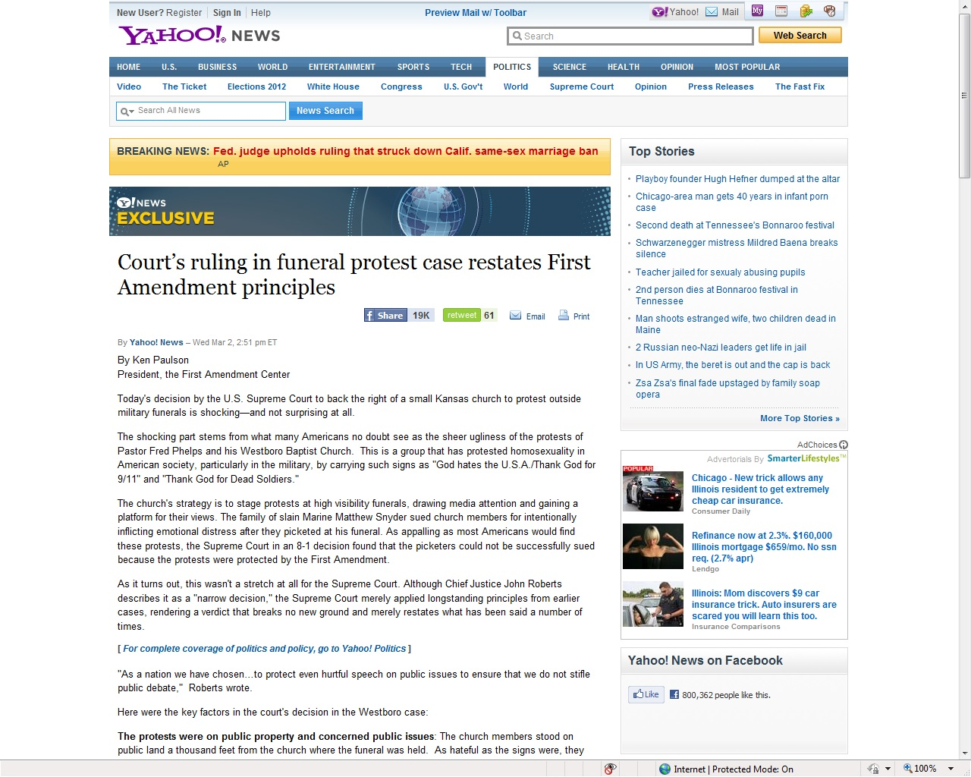

Slide 9
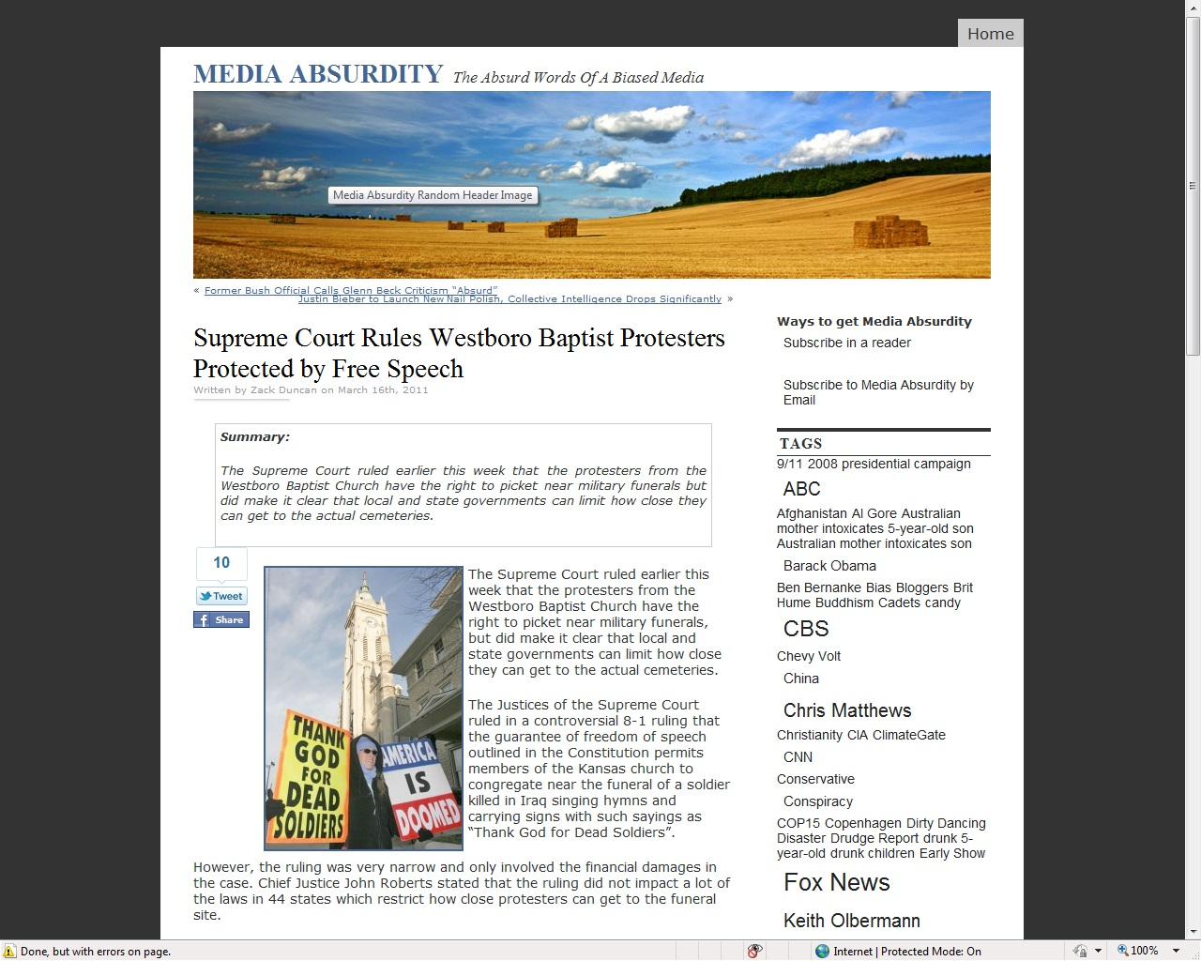

Slide 10
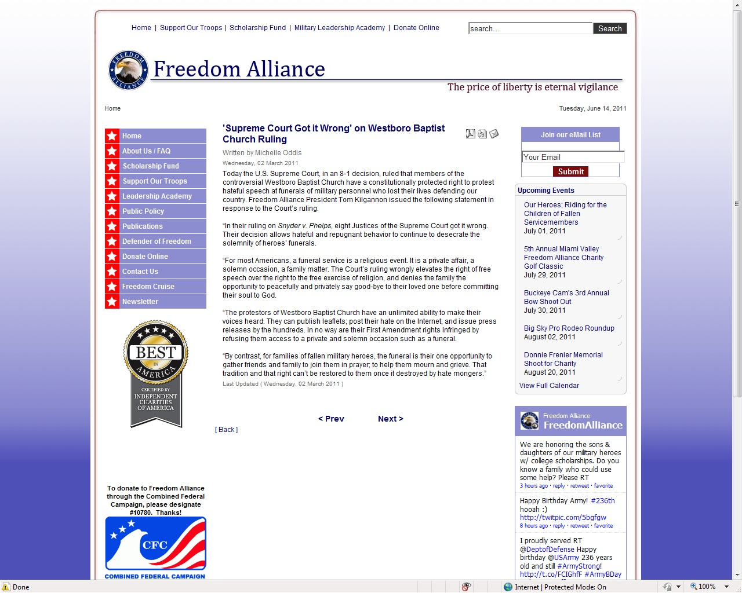

Slide 11
Making sense of the news…
Some news gathering organizations have resources to help
teachers use news in the classroom. Many of these resources are
developed by education experts.
Resources include:
-Lesson plans
-Discussion questions
-News quizzes
-Student activities
-Suggested resources for student research
-Student discussion forums

Slide 12
Freedom in the News
Freedom in the News is an e-newsletter that aggregates news stories on First Amendment issues and other freedom issues. The categories are:
The Five Freedoms
Student Freedoms
Civil rights
Gender equity
Immigration
Native American rights
Slavery
Worker’s rights
Abortion and reproductive rights
Crime and punishment
Death penalty
Disability rights
Elections and voting
Gay rights
Gun rights
Homeland Security
Smoking rights
Stem cell research
Privacy rights
Property rights
State’s rights
Federal courts
Supreme Court

Slide 13
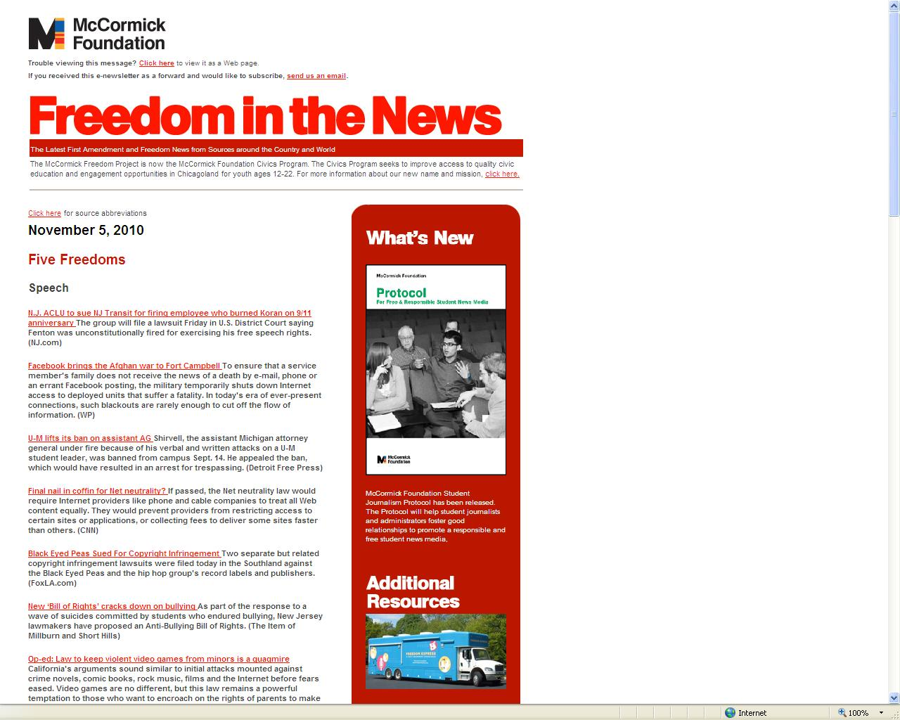

Slide 14
Headline examples
Stevenson High School principal will no longer preview newspaper Stevenson
High School officials, at one time accused of censoring the student newspaper,
informed a jubilant senior editor Wednesday that the principal no longer feels the
need to preview the newspaper before publication. (CT)
Second book challenged and removed in Bedford A second book has been pulled
from the Bedford High School curriculum following complaints about its sexual
content by the same parents who started the argument about “Nickel and Dimed:
On Not Getting By In America,” which was removed from the high school’s
personal finance course last month. (Nashua Telegraph)
Edmonds student suspended for going off-script Pascal knew that giving an
unapproved speech would get him disqualified as a candidate. What he didn’t
expect was getting suspended for a day and a half. He spent that time alone in a
school conference room, punishment he called “solitary confinement.” (The
Enterprise)

Slide 15
Headline examples
Former NCAA player's suit threatens Hollywood Keller's lawsuit has also
unexpectedly ballooned into a major First Amendment challenge, prompting
Hollywood's largest movie studios and dozens of other interests — from the estates
of reggae legend Bob Marley and Nobel laureate John Steinbeck to ESPN and the
Comic Book Legal Defense Fund — to weigh in on the case. (AP)
Artwork with Confederate flag removed from Ga. exhibit A college president says she ordered an instructor's painting removed from a faculty art exhibit amid controversy about the piece, which features a Confederate flag. The flag is superimposed on images that include a hanged black man and a hooded Ku Klux Klansman, the Athens Banner-Herald reported. (AP)
Ky. governor OKs posting of God phrases in Capitol walkway A legislative chaplain received permission Feb. 4 to post excerpts from historical documents that reference God in a Capitol walkway, settling a dispute that had raised the ire of lawmakers and ministers. (AP)

Slide 16
Headline examples
N.Y. assemblyman introduces school-uniform bill Public school students —
elementary, middle and high school — will wear school uniforms if a measure in the New
York General Assembly becomes law. (FAC)
N.Y. school blocks teens' Bieber T-shirts A group of high school girls in New York say their
informal Justin Bieber fan club almost got them suspended because it crossed school
rules on gang attire. (UPI)
Full 3rd Circuit: Pa. teens can’t be suspended for MySpace postings Two Pennsylvania teens cannot be disciplined at school for MySpace parodies of their principals created on home computers, a federal appeals court ruled yesterday in two high-profile cases involving students and free speech. (AP)
House Democrats say Justice Thomas should recuse himself in health-care case
Seventy-four House Democrats have signed a letter to Clarence Thomas asking
the Supreme Court justice to recuse himself from any deliberations on the
constitutionality of the national health care overhaul, arguing that his wife's work as
a lobbyist creates "the appearance of a conflict of interest." (WP)

Slide 17
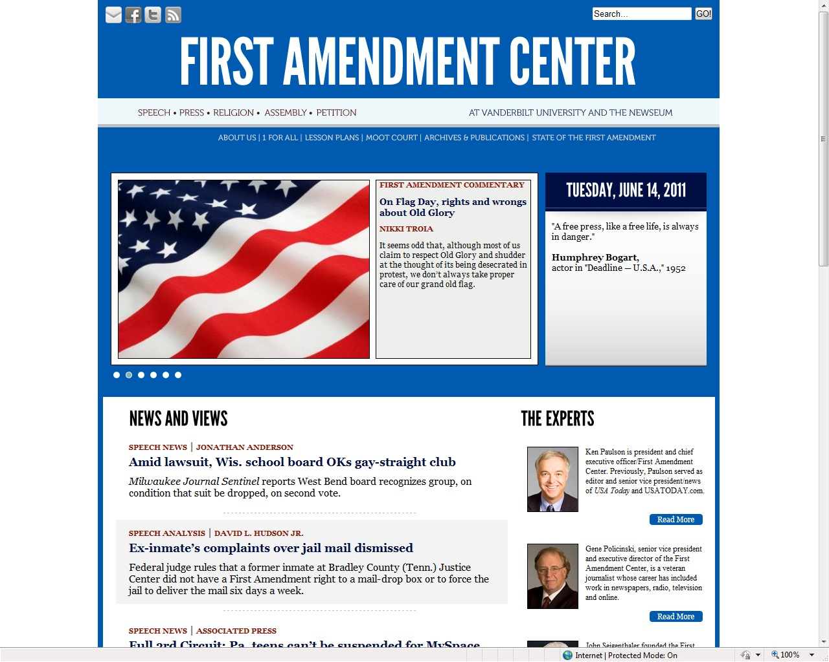

Slide 18
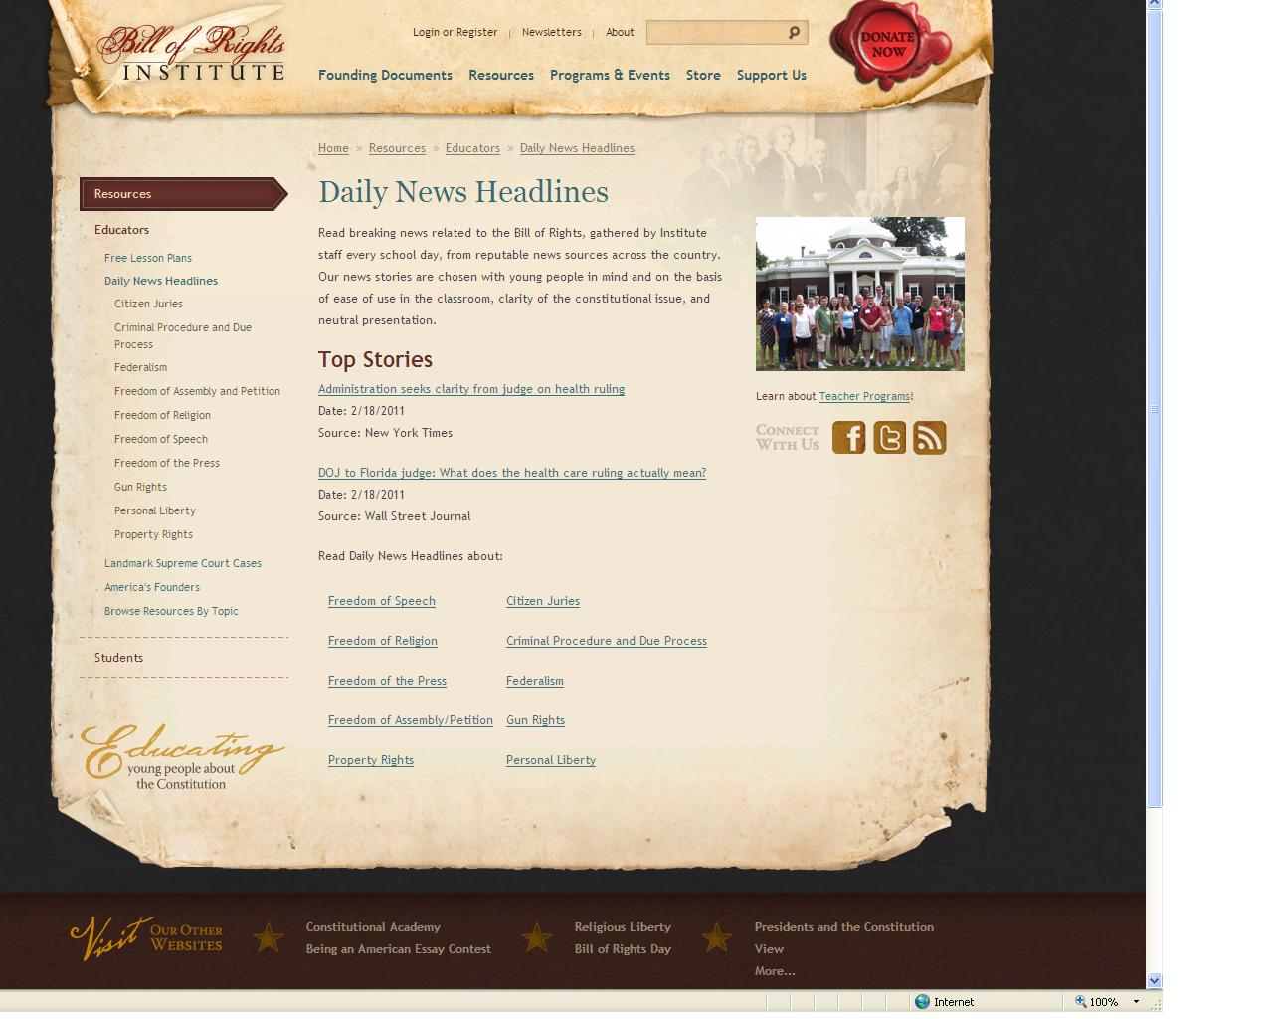

Slide 19
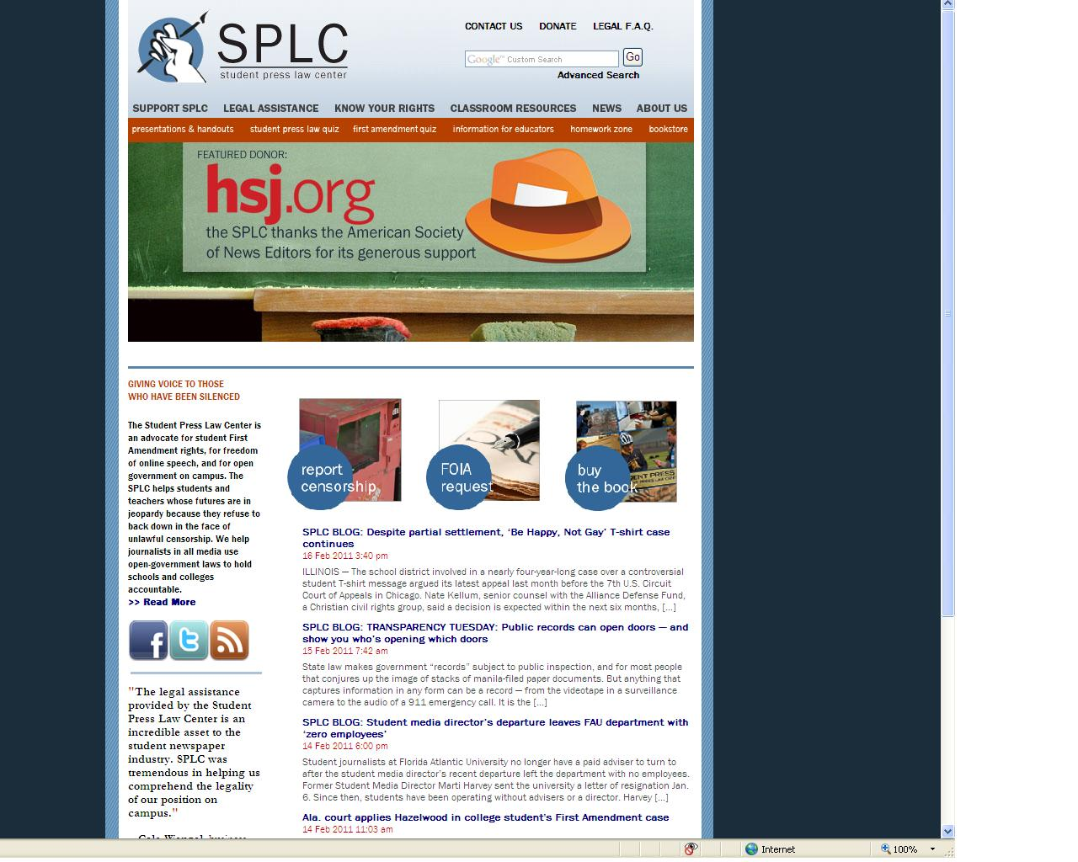

Slide 20
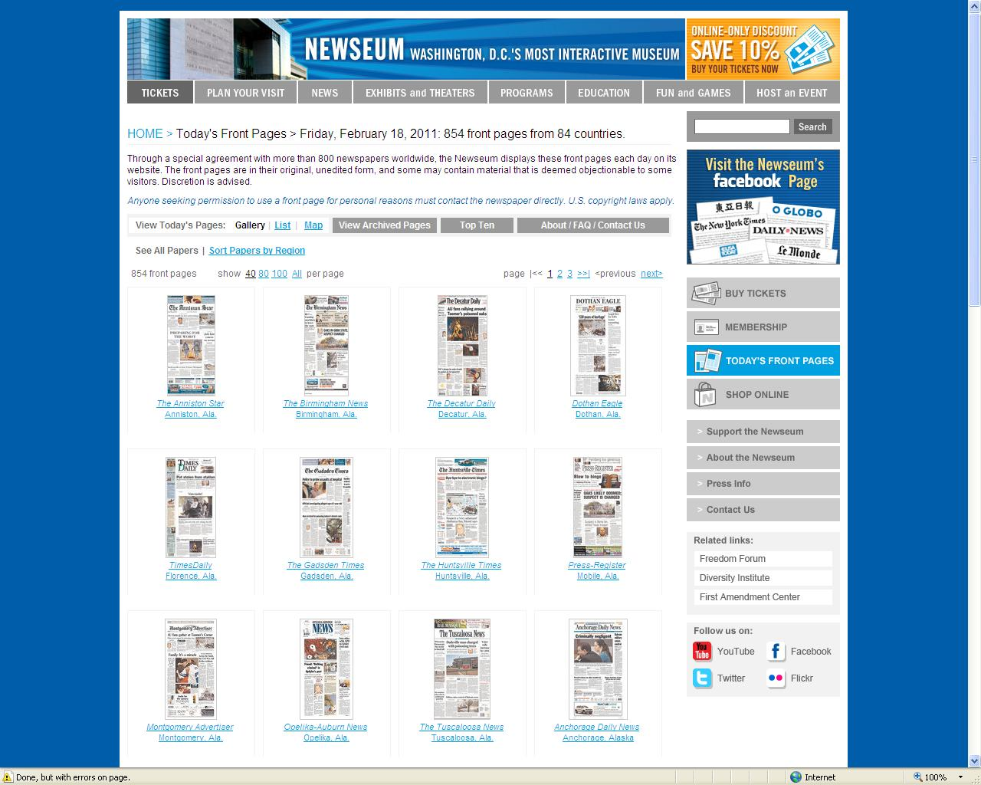

Slide 21
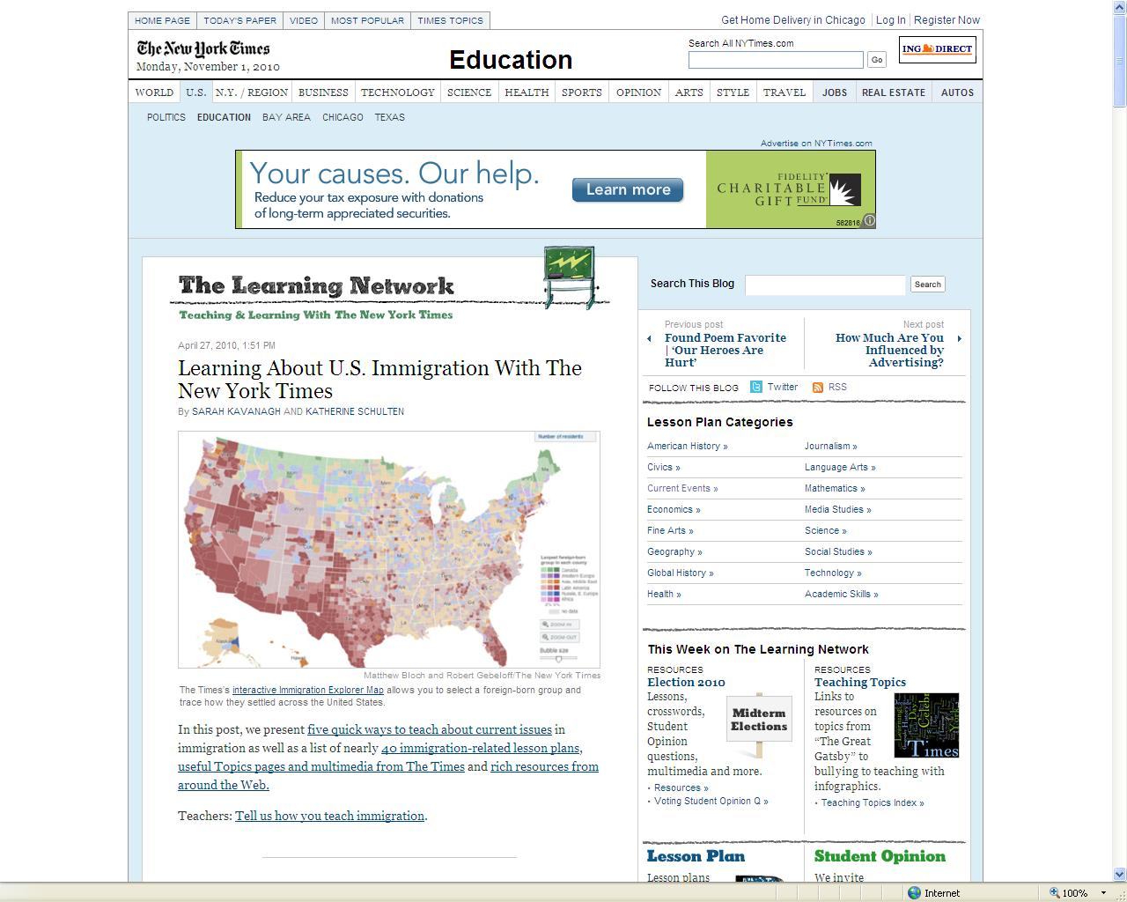

Slide 22
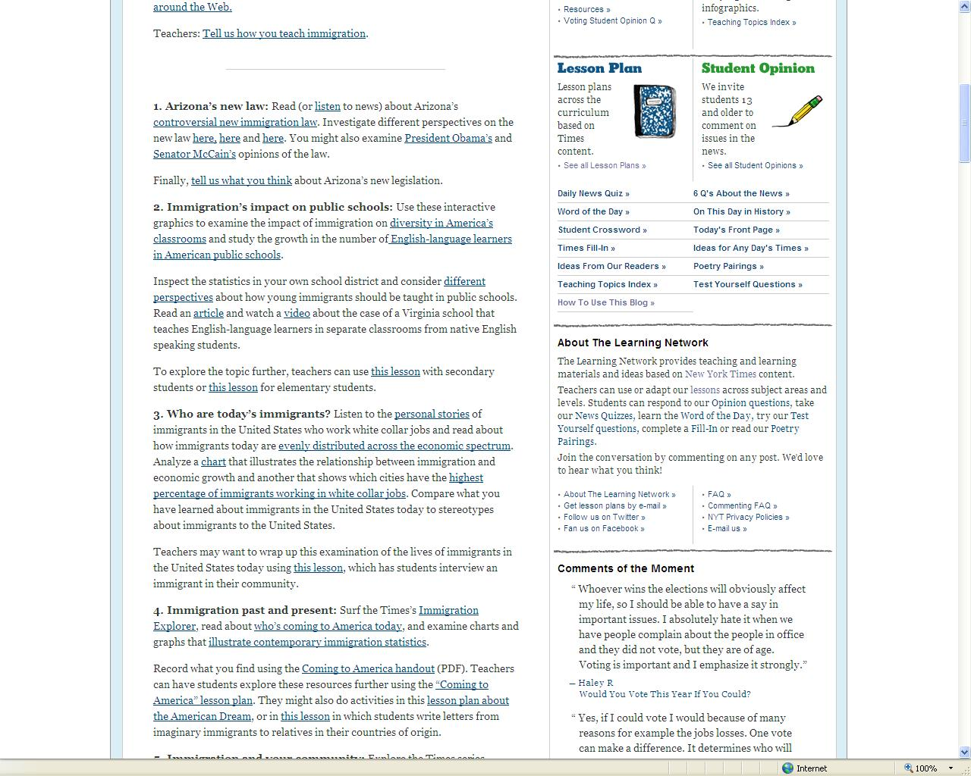

Slide 23
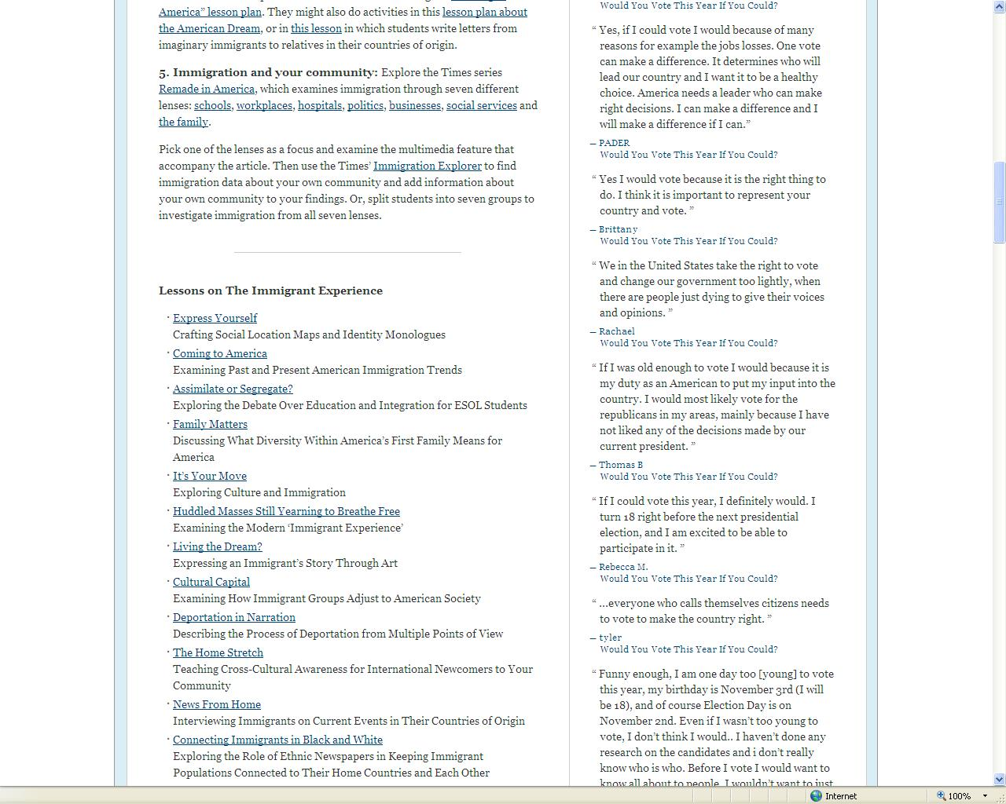

Slide 26
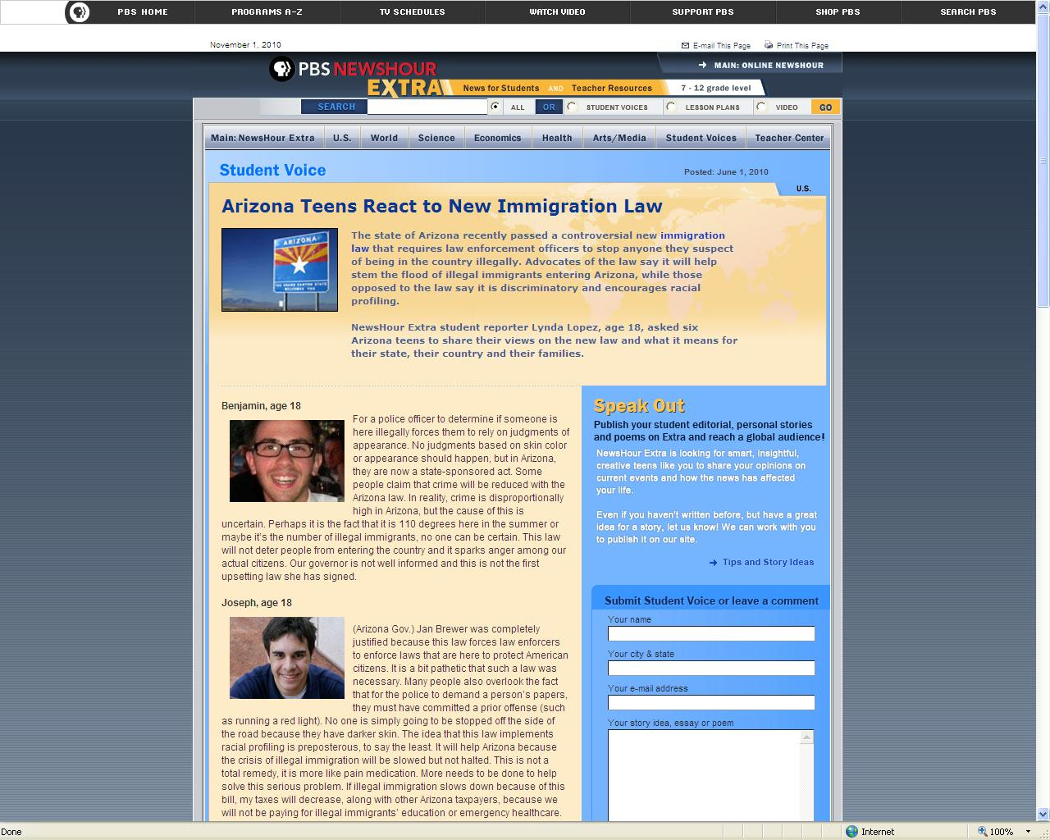

Slide 27
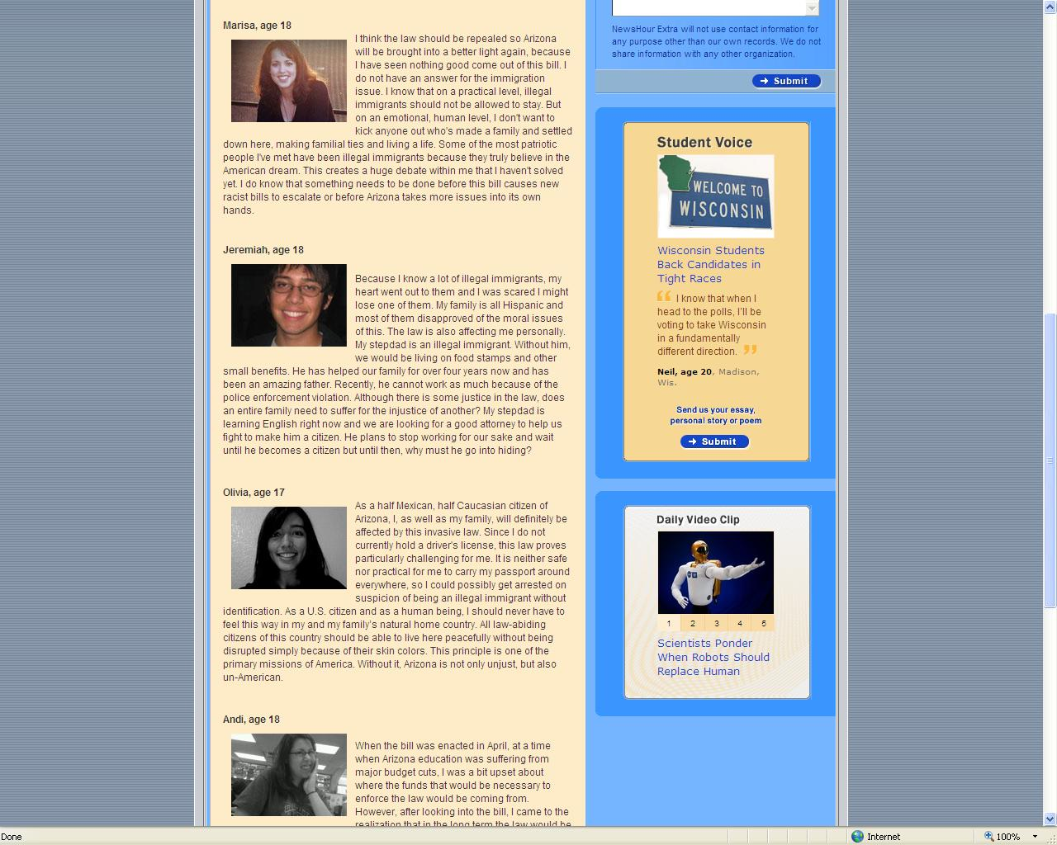

Slide 28
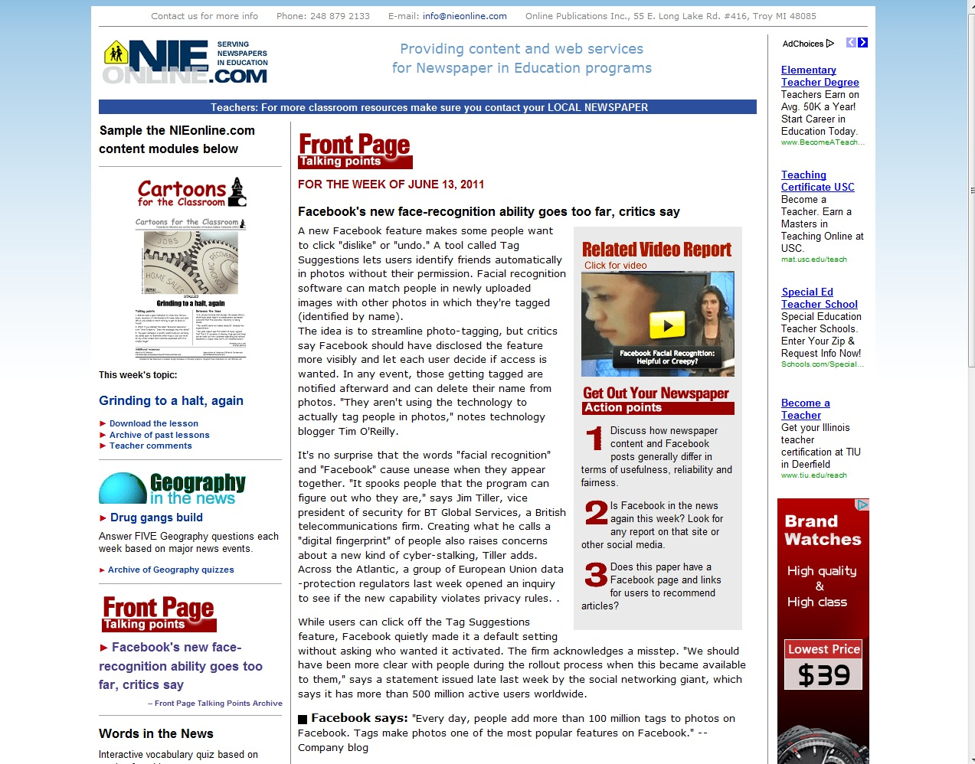

Slide 29
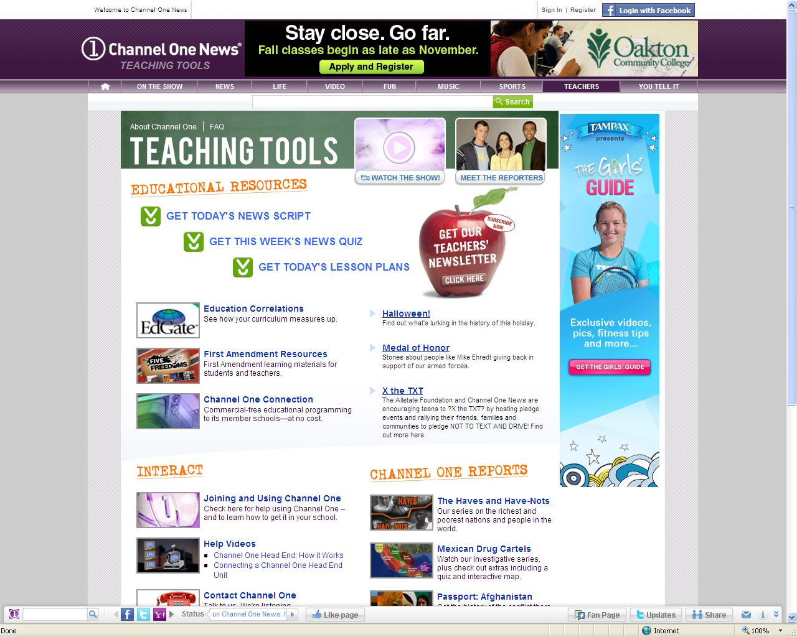

Slide 30
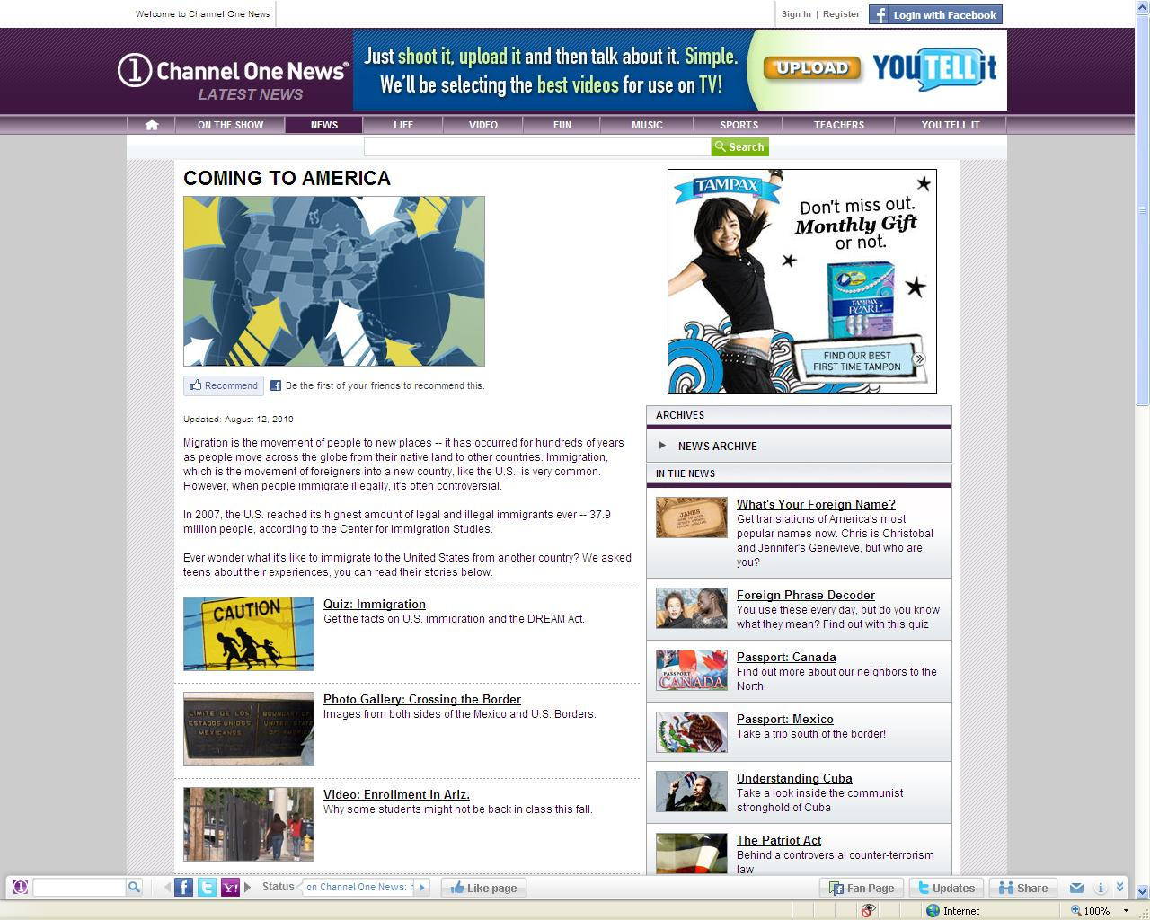

Slide 31
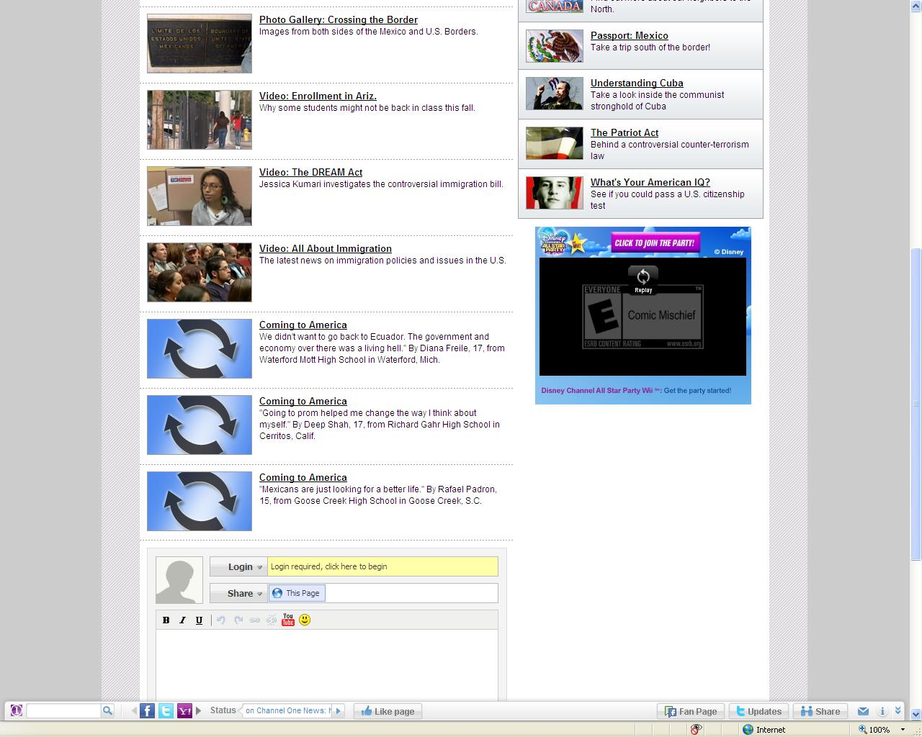

Slide 32
Questions?

