Slide 1
Global View of the First Amendment
Shawn Healy
Resident Scholar
McCormick Foundation Civics Program

Slide 2
Overview: First Amendment Global View
1. Why Teach the First Amendment?
2. First Amendment Overview
3. Freedom of Religion
Establishment Clause
Free Exercise Clause
4. Freedom of Speech and Press
Categorical exceptions
Tiers of constitutional scrutiny
Prior restraint
Student speech and press
5. Ancillary issues
2
Notes:
2

Slide 3
Why Teach the First Amendment?
The Simpson’s Survey (2006)
Only one in four Americans (28%) can name more than one of the five freedoms of the First Amendment
Twice as many (52%) can name two or more characters of the fictional Simpson family
Among survey participants, recall of the five freedoms revealed the following frequencies:
Speech: 69%
Religion: 24%
Press: 11%
Assembly: 10%
Petition: 1%
3
Notes:
3

Slide 4
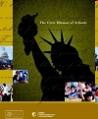
Why Teach the First Amendment?
● The Civic Mission of Schools Report (2003): Six promising approaches outlined by the Civic Mission of Schools
1. Formal instruction in US Government, history, law, and democracy using interactive methods and opportunities to apply learning to “real-life” situations.
2. Discussion of current local, national and international
events that students view as important to their lives and
controversial political and social issues within political and social context.
3. Service learning linked to the formal curriculum and
classroom instruction.
4. Extracurricular activities that encourage greater
involvement and connection to school and community.
5. Authentic voice in school governance.
6. Participation in simulations of government structures and processes.

Slide 5
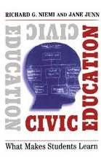
Why Teach the First Amendment?
Civic Education: What Makes Students Learn (Niemi and Junn, 1998)
Rationale for teaching civics:
1. “…From an instrumental standpoint, knowledge is a prerequisite to successful political engagement.”
2. Citizens must have knowledge of basic principles, the rules of the democratic game
3. “…Political knowledge helps citizens operate effectively in a democracy, heightens their awareness of the limits of both governmental and citizen behavior, increases attainment of democratic goals by promoting more equal access among citizens, and contributes to the extent to which citizens regard their government with confidence and satisfaction.”
“…Civics courses do have an effect on student knowledge, an effect that is wide-ranging in terms of content…and that also appears to raise students’ capacity for reasoning and exposition about civic matters.”
“…What the teacher brings to the classroom by the way of methods and material—in ways that are understandable and theoretically plausible—seems to be an important factor in what students take away from their classes.”
5
Notes:
5

Slide 6
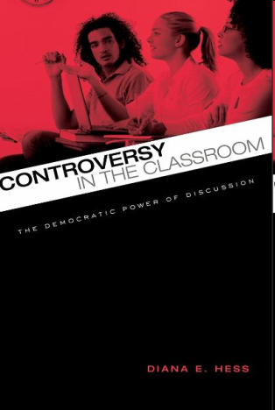
Why Teach the First Amendment?
Controversy in the Classroom (Hess, 2009)
Disturbing evidence of a dearth of political discussions among people with dissenting views (Bishop, 2008; Mutz, 2006)
“…There is an intrinsic and crucial connection between the discussion of controversial issues, especially among young people with disparate views, and the health of democracy.” (Hess)
Schools as a transformational site to facilitate such dialogue
“We have to get young people comfortable with conflict. That’s when they’re more likely to engage politically. If we rely just on families to do this, it isn’t going to happen. Civic education has the potential to tap the openness of young people to arguments on both sides of important issues.”
6
Notes:
6

Slide 7
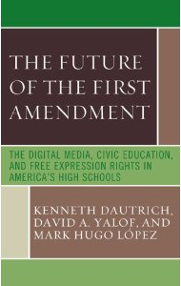
Why Teach the First Amendment?
The Future of the First Amendment (2008)
“…Those high school students who take classes with First Amendment or media and society content are more likely to support the exercise of free expression rights.”
Overall, student support for the First Amendment is lower than that of adults, including their teachers and administrators.
However, First Amendment rights in application attract stronger support, including music censorship and prior review of student newspapers.
7
Notes:
7

Slide 8
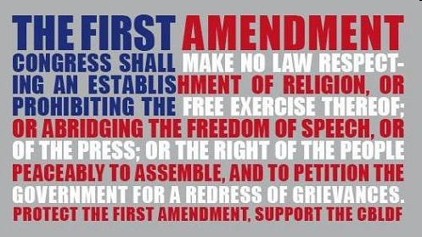
First Amendment Overview
“Congress shall make no law respecting an establishment of religion, or prohibiting the free exercise thereof; or abridging the freedom of speech, or of the press; or the right of the people peaceably to assemble, and to petition the government for a redress of grievances.”
8
Notes:
8

Slide 9
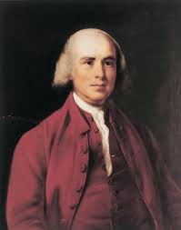
First Amendment Overview
Federalists vs. antifederalists: 8 of 13 states ratified the Constitution under the condition that a Bill of Rights be adopted during the First Congress
Madison does an about-face
See the First Amendment in Schools, Page 13, for seeds of the First Amendment
From third to first: Preceded originally by amendments concerning reapportionment and congressional pay
-Ratified on December 15, 1791 (VA was the clincher)
The five freedoms are foundational for democratic government in the United States
-Tied to the assertion of other rights
9
Notes:
9

Slide 10
First Amendment Overview
“Congress shall make no law…”: Limits government or its agents, not private parties
-Known as state action
Bill of Rights, the First Amendment included, applied originally to the states only
-Madison attempted to have freedom of conscience, speech, and press applied to states, but was rejected by the Senate on this front
All rights have limitations: Only exception being freedom to believe in abstract ideas
-Government may regulate actions that embody these ideas
Federal courts’ First Amendment ceilings establish a floor, not a ceiling
10
Notes:
10

Slide 11
Freedom of Religion
Establishment Clause: “Congress shall make no law respecting the establishment of religion…”
- Most Establishment Clause cases center on education. Prior to universal public education, schools were largely church-run. Because modern public schools are governmental entities, First Amendment issues regularly surface
-Controlling case: Lemon v. Kurtzman (1971)
-See Lee v. Weisman (1992) video
Free Exercise Clause: “Or prohibit the free exercise thereof…”
-Reverse side of the coin: Protects individuals from government encroachment on their own beliefs
-Most modern Free Exercise cases do not center on discrimination against a specific denomination, but instead laws that have a negative impact on a particular religious group
-Controlling case: Oregon v. Smith (1990)
11
Notes:
11

Slide 12
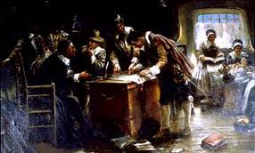
Freedom of Speech and Press
Speech and Press Clauses: “Congress shall make no law…abridging…the freedom of speech or of the press…”
Speech
- First protected in the Magna Carta (1215) and the English Bill of Rights (1689)
-Appeared in the Massachusetts Body of Liberties (1641)
-Mentioned in several state constitutions, and three states recommended inclusion in the Bill of Rights
Press
-Licensing of the press was the norm under colonial legislatures
-Seditious libel reigned: Could be convicted for publishing government critiques, and truth was no defense
-Virginia the first state to protect press freedoms in its Constitution
-More states recommended press freedom for the Bill of
Rights than they did speech
12
Notes:
12

Slide 13
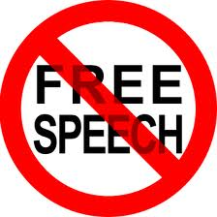
Freedom of Speech and Press
Categorical exceptions: Not protected by the First Amendment
-Fighting words: Spoken words that instigate violent reactions
Controlling case: Chaplinsky v. New Hampshire (1942)
-Defamation: Actual malice, knowingly false charges, and reckless disregard for the truth
Controlling case: New York Times v. Sullivan (1964)
-Incitement: Imminence between the call for action and the action itself
Controlling case: Brandenburg v. Ohio (1969)
-True Threat: Distinguish true threats from political hyperbole
Controlling case: Watts v. United States (1969)
-Obscenity: Apply three-part Miller Test
Controlling case: Miller v. California (1971)
13
Notes:
13

Slide 14
Freedom of Speech and Press
Tiers of constitutional scrutiny
-Strict scrutiny: Pure speech
Controlling case: Rosenberger v. Rector and Visitors of the University of Virginia (1995)
-Intermediate scrutiny: Speech plus
Controlling case: United States v. O’Brien (1968)
-Reasonableness: Content-neutral time, place, and manner restrictions
Controlling case: Ward v. Rock Against Racism (1989)
Strict Scrutiny
Intermediate Scrutiny
Reasonableness
High
Low
14
Notes:
14

Slide 15
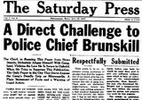
Freedom of Speech and Press
Prior restraint
-Prohibited with few exceptions
Controlling case: Near v. Minnesota (1931)
Student speech and press
- Students in public schools enjoy First Amendment protections depending on the type of expression and their age. The Court has distinguished between elementary and secondary schools and public colleges and universities
-Limitations include:
Material and substantial disruptions: Tinker v. Des Moines (1969)
Vulgar or lewd speech: Bethel v. Fraser (1986)
Reasonably related to legitimate pedagogical concerns: Hazelwood v. Kuhlmeier (1988)
Drug-related speech: Morse v. Frederick (2007)
15
Notes:
15

Slide 16
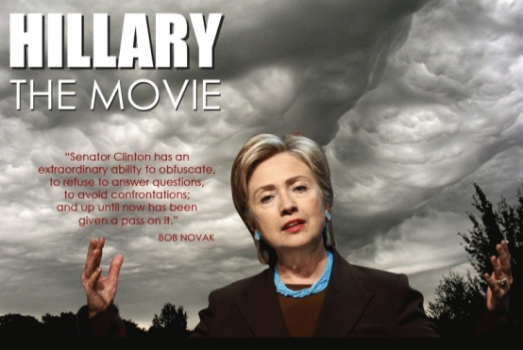
Ancillary Issues
Campaign finance
-Contribution limits permissible, but not spending limits
Controlling case: Buckley v. Valeo (1976)
-Soft money limits on political parties also upheld
Controlling case: FEC v. McConnell (2003)
-Corporate funding of political broadcasting during campaigns upheld, as is ban on corporate and union contributions to individual candidates
Controlling case: Citizens United, Inc. v. FEC (2010)
Commercial speech
-Speech that does no more than propose a
commercial transaction
Advertising must concern lawful activity and not be misleading
Government must demonstrate a substantial interest
Regulation must directly advance this interest
Regulation must not be more extensive than necessary
Controlling case: Central Hudson v. Public Service Commission of New York (1980)
16
Notes:
16

Slide 17
Ancillary Issues
Freedom of association
- Implicit right associated with the 1st, 5th, and 14th Amendments
-Not a right to social association (see Boy Scouts v. Dale, 2000)
-The government may:
Prohibit people from knowingly associating in groups that engage and promote illegal activities
Not require a group to register or disclose its members or from denying government benefits on the basis of an individual's current or past membership in a particular group
Not compel individuals to express themselves, hold certain beliefs, or belong to particular associations or groups
Freedom of information
Intellectual freedom
Copyright laws
17
Notes:
17

Slide 18
Global View of the First Amendment
Questions?

