Slide 1
First Amendment Quiz
Shawn Healy and Janice Belzowski
Resident Scholar and Professional Development Coordinator
McCormick Foundation Civics Program

Slide 2
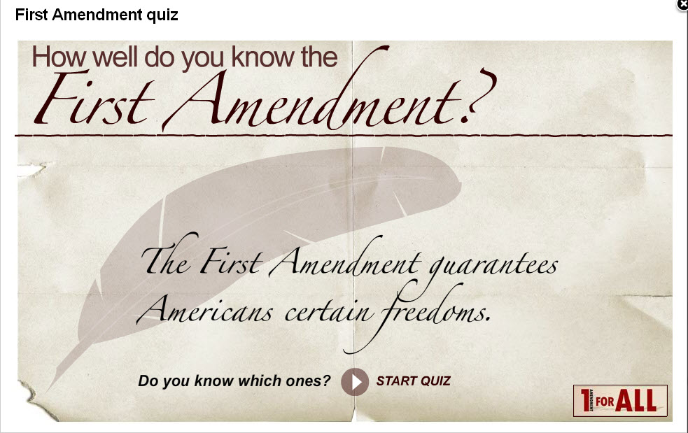

Slide 3
Question 1
How many freedoms are named in the First Amendment?
One
Five
Three
Ten
Notes:
In 2005, we reached a key milestone in the foundation’s history - our 50th Anniversary. To honor our legacy and promote this achievement, we’ve launched several initiatives.

Slide 4
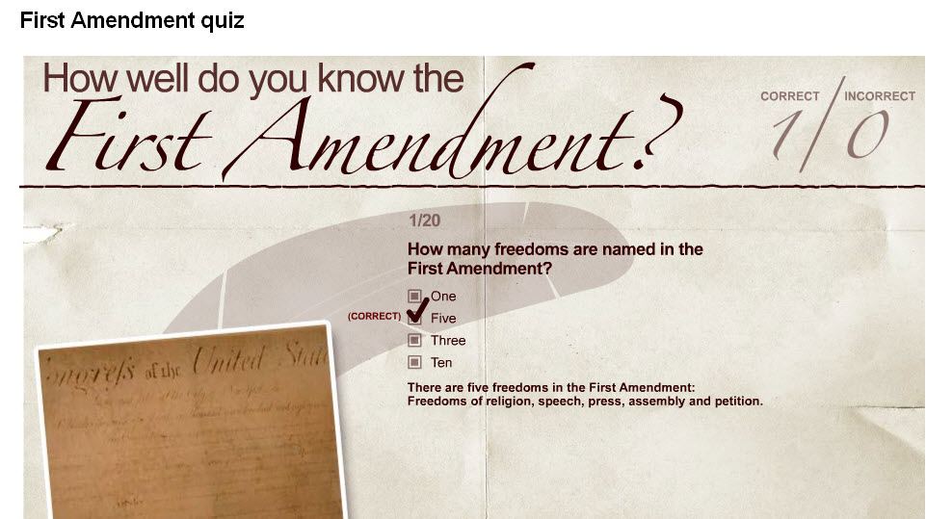
Notes:
In 2005, we reached a key milestone in the foundation’s history - our 50th Anniversary. To honor our legacy and promote this achievement, we’ve launched several initiatives.

Slide 5
Question 2
What Freedoms are NOT in the First Amendment?
Right to Bear Arms
Right to Free Enterprise
Right to a speedy and public trial
All of the above
None of the Above
Notes:
In 2005, we reached a key milestone in the foundation’s history - our 50th Anniversary. To honor our legacy and promote this achievement, we’ve launched several initiatives.

Slide 6
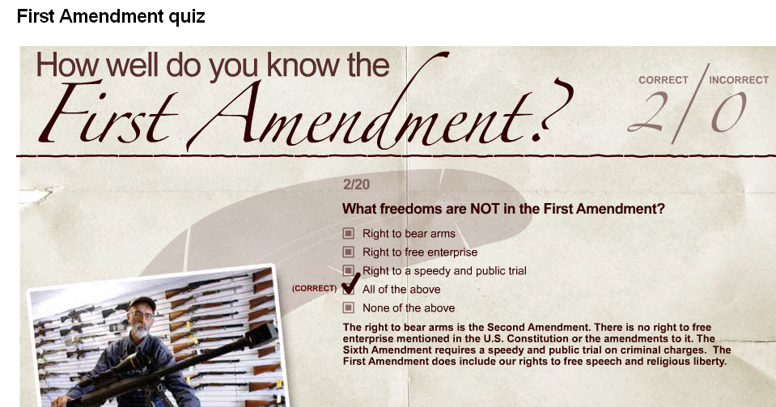
Notes:
In 2005, we reached a key milestone in the foundation’s history - our 50th Anniversary. To honor our legacy and promote this achievement, we’ve launched several initiatives.

Slide 7
Question 3
When did the Supreme Court first decide that the internet is protected by the First Amendment?
2004
1997
Will review this term
Never
Notes:
In 2005, we reached a key milestone in the foundation’s history - our 50th Anniversary. To honor our legacy and promote this achievement, we’ve launched several initiatives.

Slide 8
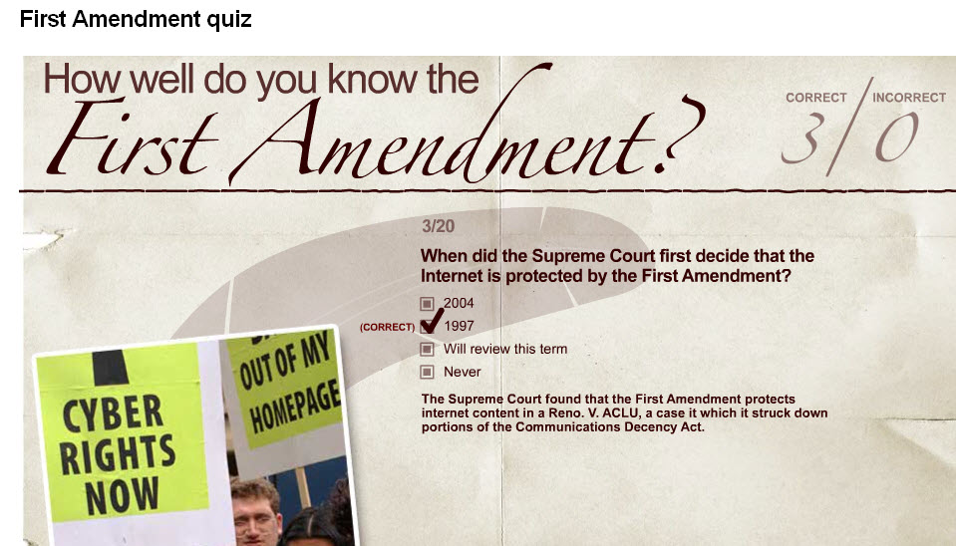
Notes:
In 2005, we reached a key milestone in the foundation’s history - our 50th Anniversary. To honor our legacy and promote this achievement, we’ve launched several initiatives.

Slide 9
Question 4
Which of these has no First Amendment protection?
Pornography
Poetry
Obscenity
Comic Books
Notes:
In 2005, we reached a key milestone in the foundation’s history - our 50th Anniversary. To honor our legacy and promote this achievement, we’ve launched several initiatives.

Slide 10
Notes:
In 2005, we reached a key milestone in the foundation’s history - our 50th Anniversary. To honor our legacy and promote this achievement, we’ve launched several initiatives.

Slide 11
Question 5
A protest march is made possible by which First Amendment freedom?
Right of assembly
Freedom of the Press
Freedom of religion
Freedom of speech
Notes:
In 2005, we reached a key milestone in the foundation’s history - our 50th Anniversary. To honor our legacy and promote this achievement, we’ve launched several initiatives.

Slide 12
Notes:
In 2005, we reached a key milestone in the foundation’s history - our 50th Anniversary. To honor our legacy and promote this achievement, we’ve launched several initiatives.

Slide 13
Question 6
The First Amendment Protects us against:
The Federal Government
All U.S. governmental bodies
Public criticism
Crude jokes
Notes:
In 2005, we reached a key milestone in the foundation’s history - our 50th Anniversary. To honor our legacy and promote this achievement, we’ve launched several initiatives.

Slide 14
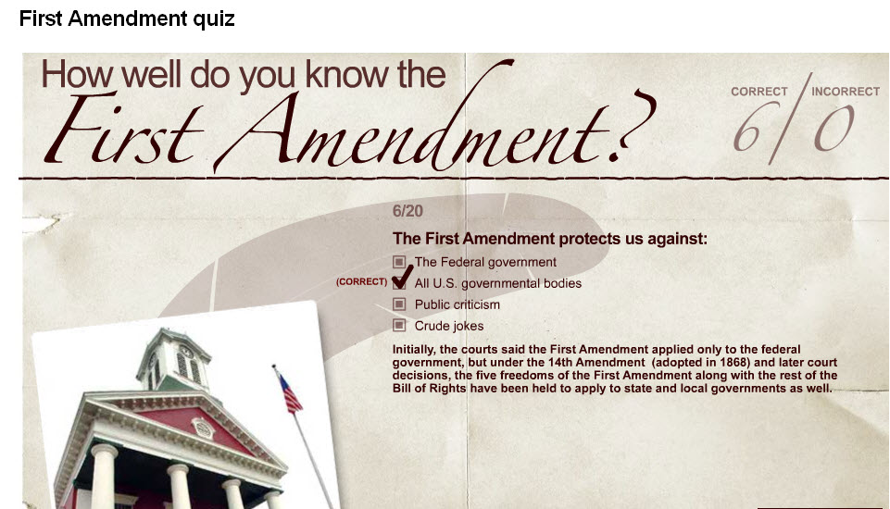
Notes:
In 2005, we reached a key milestone in the foundation’s history - our 50th Anniversary. To honor our legacy and promote this achievement, we’ve launched several initiatives.

Slide 15
Question 7
The “Father of the First Amendment” is:
George Washington
Thomas Jefferson
Alexander Hamilton
James Madison
Oliver Wendell Holmes
Notes:
In 2005, we reached a key milestone in the foundation’s history - our 50th Anniversary. To honor our legacy and promote this achievement, we’ve launched several initiatives.

Slide 16
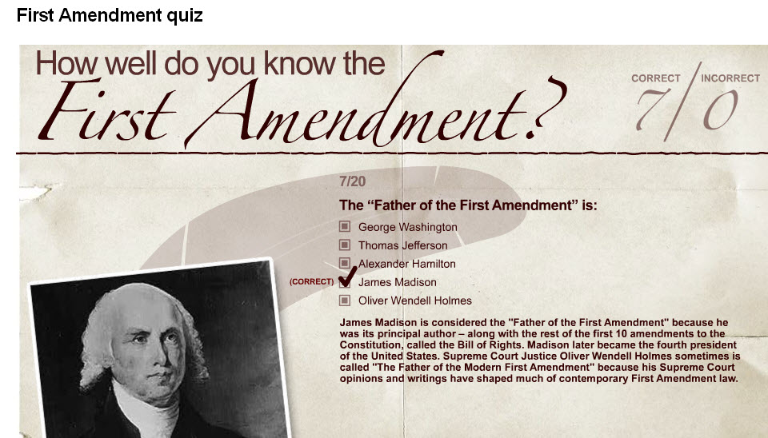
Notes:
In 2005, we reached a key milestone in the foundation’s history - our 50th Anniversary. To honor our legacy and promote this achievement, we’ve launched several initiatives.

Slide 17
Question 8
When was the First Amendment adopted?
1776
1789
1791
1865
Notes:
In 2005, we reached a key milestone in the foundation’s history - our 50th Anniversary. To honor our legacy and promote this achievement, we’ve launched several initiatives.

Slide 18
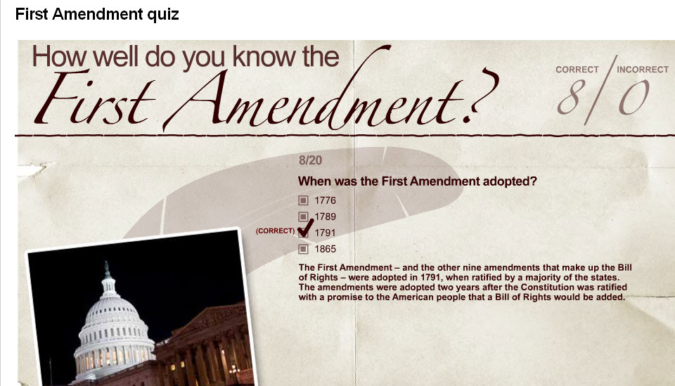
Notes:
In 2005, we reached a key milestone in the foundation’s history - our 50th Anniversary. To honor our legacy and promote this achievement, we’ve launched several initiatives.

Slide 19
Question 9
Can students successfully challenge a public school’s dress codes or requirement that students wear uniforms by claiming it violates their First Amendment right to free expression?
Yes
It depends
No
19
Notes:
19

Slide 20
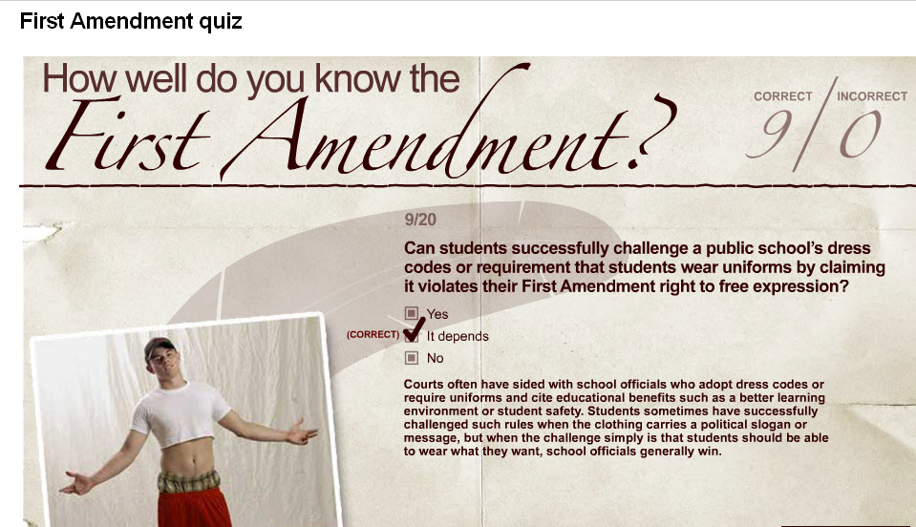
20
Notes:
20

Slide 21
Question 10
Which of these does not have First Amendment protection?
Professional sports
Ballet
Hip-hop music
Movies

Slide 22
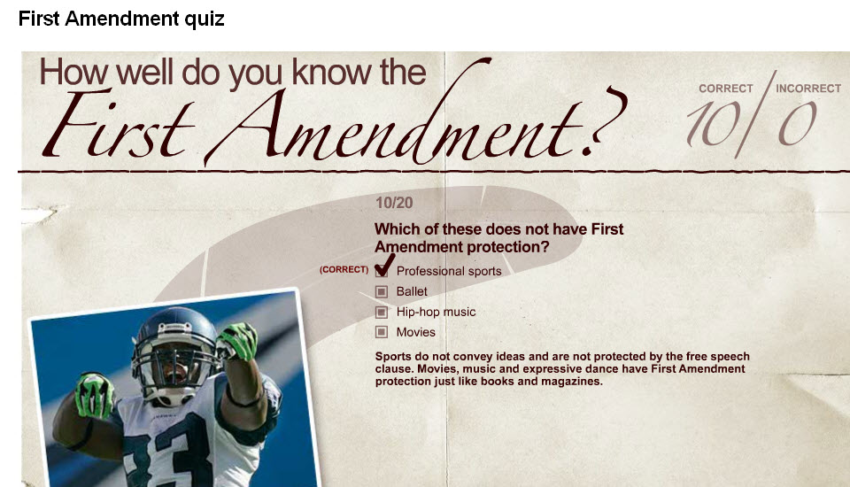
22
Notes:
22

Slide 23
Question 11
In the 1969 case involving free speech by public school students, Tinker v. Des Moines Independent Community School District, what symbol worn by the students was at the heart of the dispute?
American Flag
Iron crosses
Black peace armbands
Rosary beads
23
Notes:
23

Slide 24
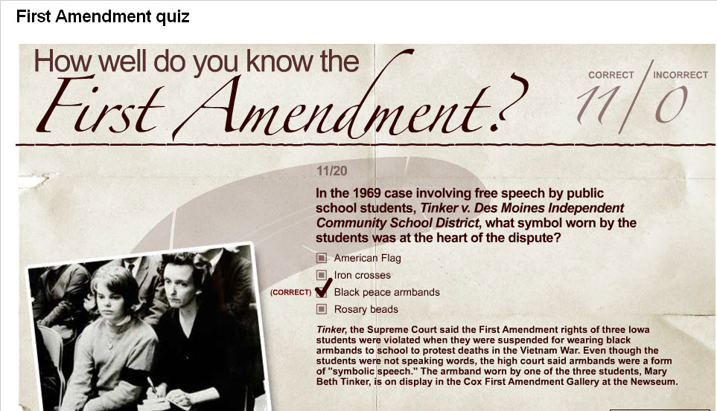
24
Notes:
24

Slide 25
Question 12
True or false? School-sponsored prayer is prohibited in public schools. That means students can’t pray in school at all, in any way.
True
False
25
Notes:
25

Slide 26
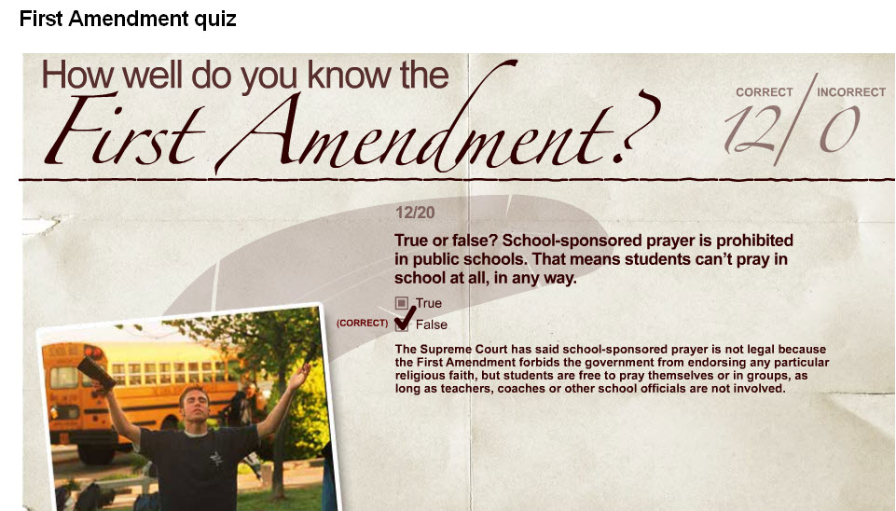
26
Notes:
26

Slide 27
Question 13
Which of these is NOT protected by the First Amendment?
A text message criticizing a public official
A protest march against illegal immigration
A threat against someone
A cartoon that makes fun of a religion
27
Notes:
27

Slide 28
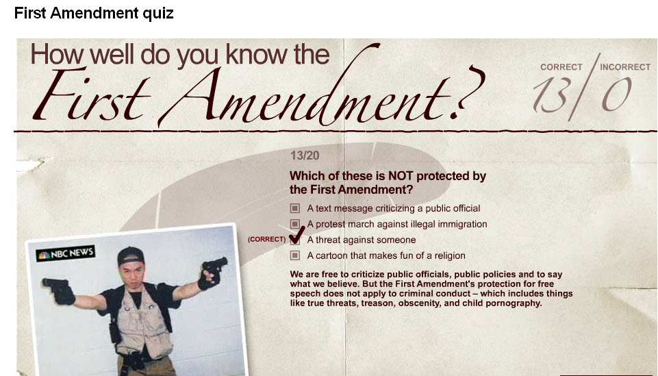
28
Notes:
28

Slide 29
Question 14
Your First Amendment freedom of assembly means you can protest:
With limits concerning “when, where and how,” but not on the message of your protest
Whenever, wherever and however you want, without restriction
Only on your own property
On someone else’s private property as long as an issue of major public interest is involved
29
Notes:
29

Slide 30
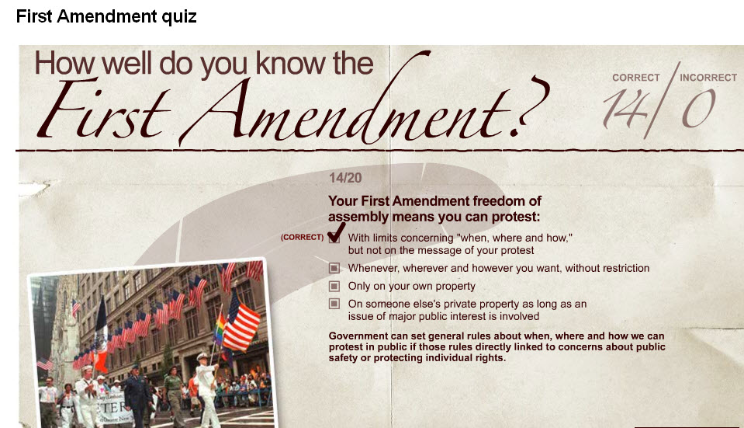
30
Notes:
30

Slide 31
Question 15
True or False? It’s against the law to burn an American flag to protest government policies.
True
False
31
Notes:
31

Slide 32
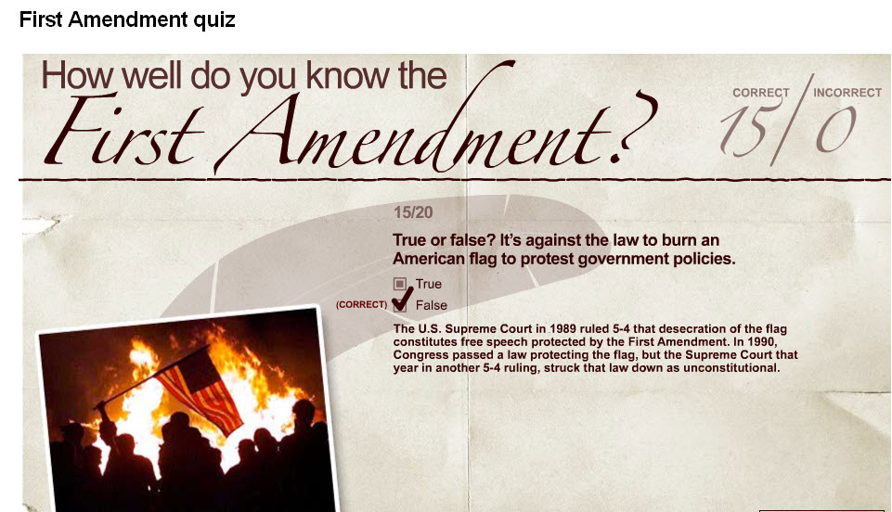
32
Notes:
32

Slide 33
Question 16
The U.S. Constitution provides that the United States is a:
Christian nation
Protestant nation
Nation of church-goers
None of the above
33
Notes:
33

Slide 34
34
Notes:
34

Slide 35
Question 17
Public school officials can censor student newspapers and Web sites:
Always
Sometimes
Never
35
Notes:
35

Slide 36
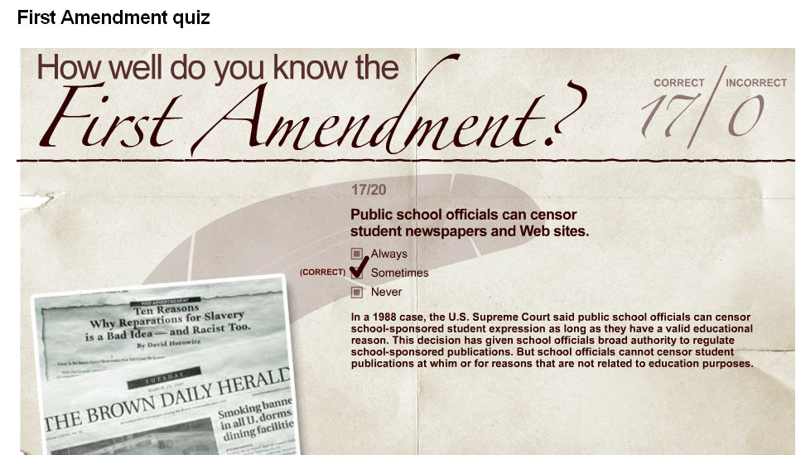
36
Notes:
36

Slide 37
Question 18
Which of these activities are protected by the free press clause?
Twitter
Comments on Facebook
Blogging about the news
All of the above
37
Notes:
37

Slide 38
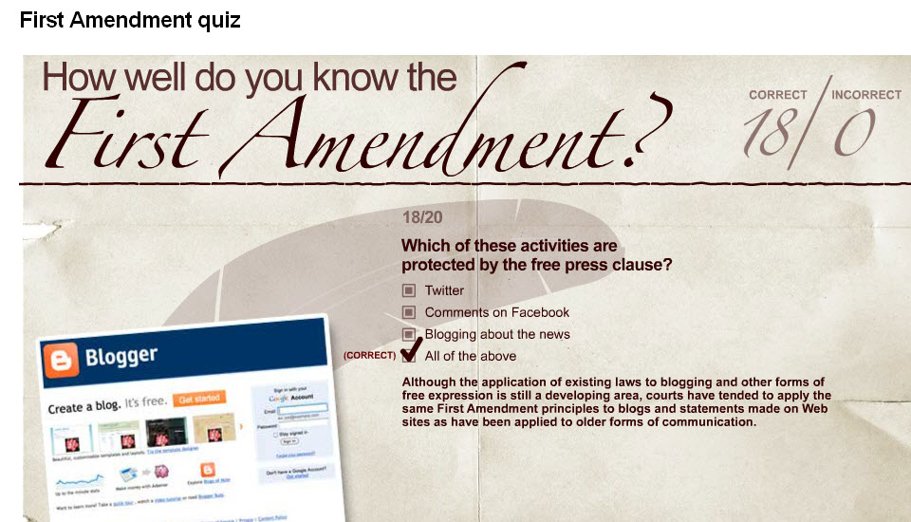
38
Notes:
38

Slide 39
Question 19
Which First Amendment right makes lobbying Congress possible?
Right to assemble
Freedom of religion
Right to petition
Freedom of the press
39
Notes:
39

Slide 40
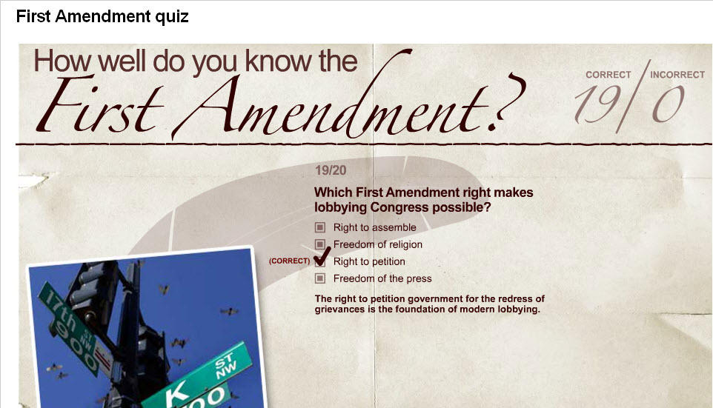
40
Notes:
40

Slide 41
Question 20
What famous American said “free speech…rocks” after a defamation law suit against her was dismissed?
Lady Gaga
Nancy Pelosi
Oprah Winfrey
Courtney Love
41
Notes:
41

Slide 42
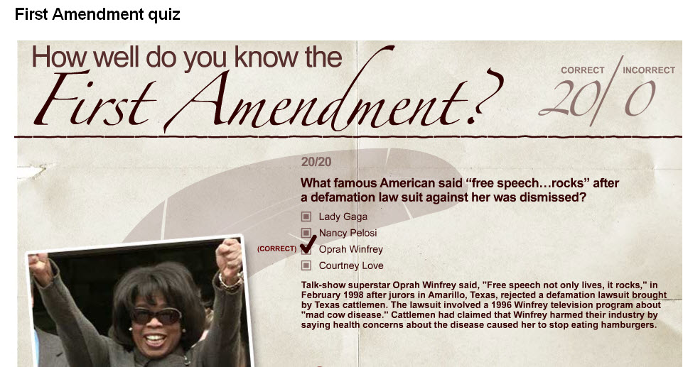
42
Notes:
42

Slide 43
First Amendment Quiz
Questions?

